Slide 1
Social Media and your Documentation: Why Should You Care?
Text here
PRESENTED BY
Jennifer White
Product Evangelist
MadCap Software

Slide 2
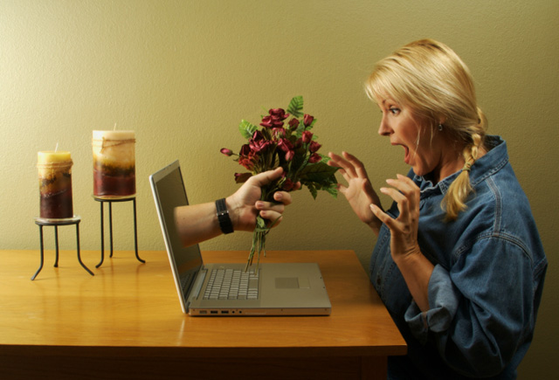

Slide 3
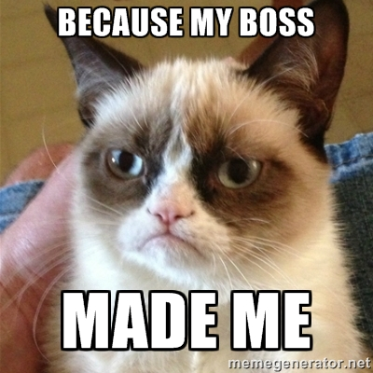

Slide 4
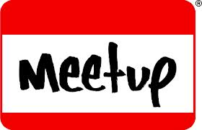

Slide 5
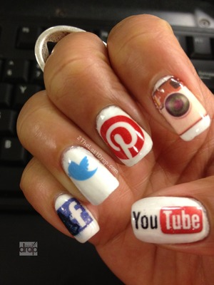
Your readers care

Slide 6
“Engagement, not data:
Our customers ask a question and we throw a canned web page at them, or a data sheet or a banner ad.
What they want is a meaningful conversation.”
Sameer Patel, General Manager/Global VP - Enterprise Social & Collaborative Software, SAP

Slide 7
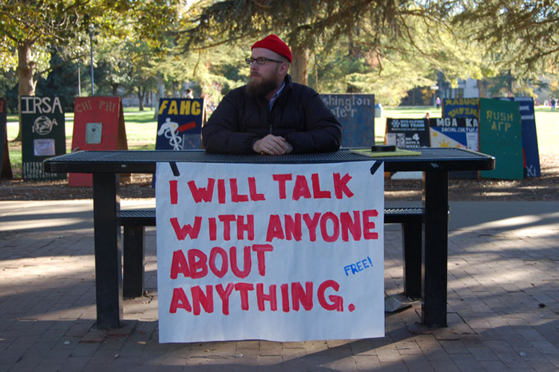
Your community already exists

Slide 8
Social interaction is documentation
“Regardless of their background, education, or training, more people are becoming providers of technical information on the web.”
Anne Gentle, Conversation and Community

Slide 9
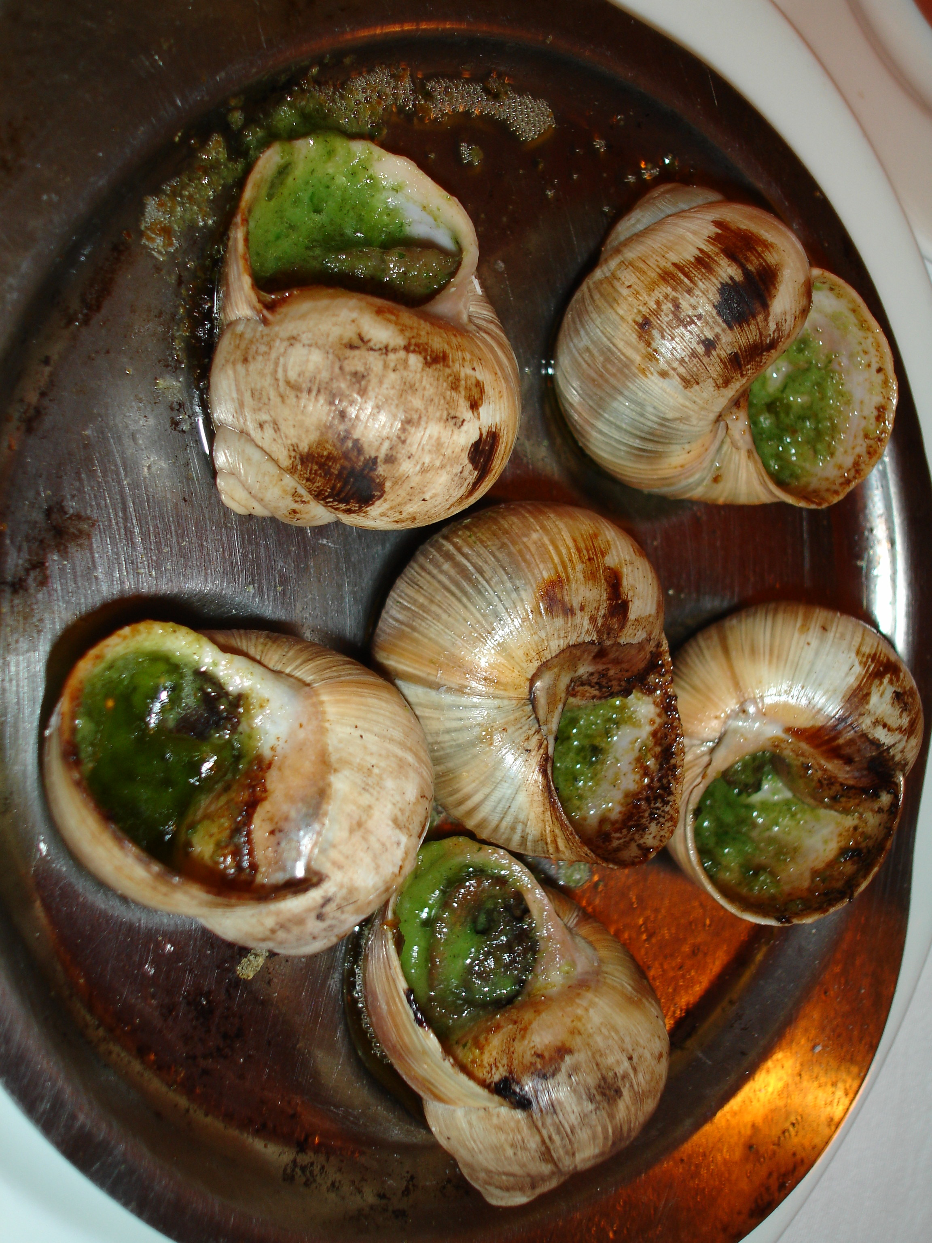

Slide 10
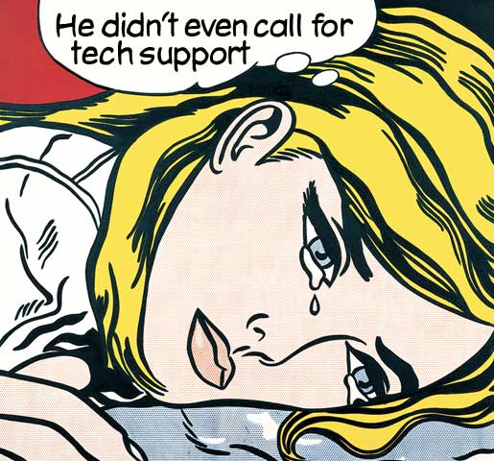

Slide 11
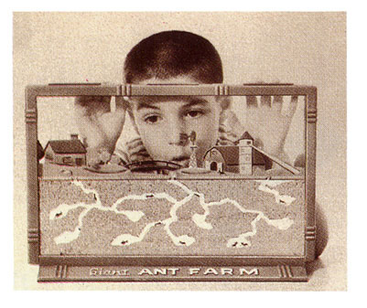
Hosting Your Own Community is better than letting somebody else do it

Slide 12
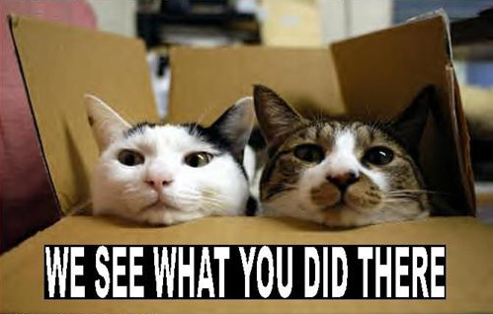
EVERYONE is watching

Slide 13
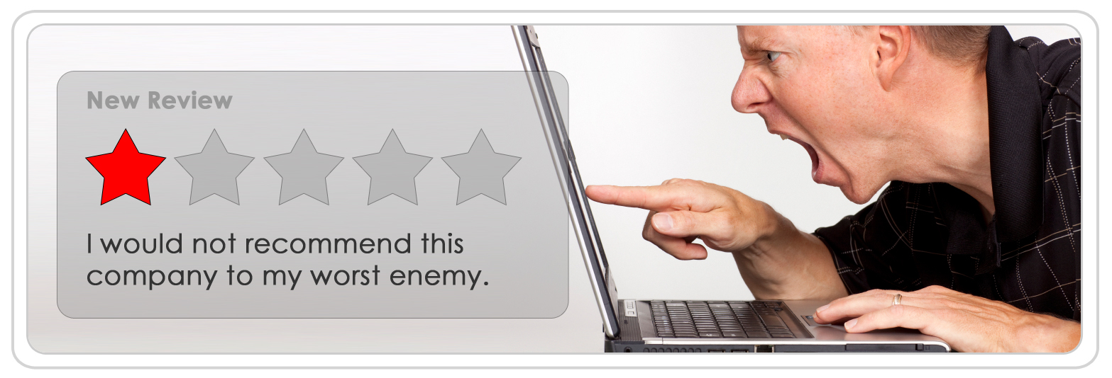
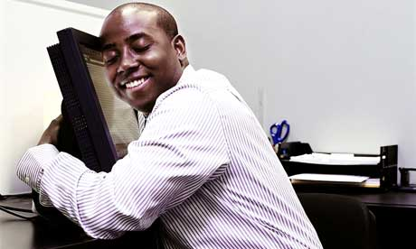
Engage with the satisfied AND dissatisfied

Slide 14
“People do business with people they have a relationship with”

Slide 15
Don’t delete!

Slide 16
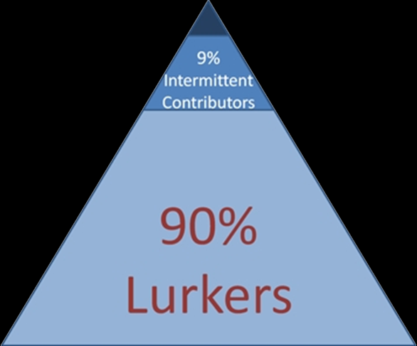
1% Heavy Contributors

Slide 17
Addressing customer issues:
48% of respondents: resource allocation is a problem
2012 edition of the Social Customer Engagement Index, Social Media Today

Slide 18
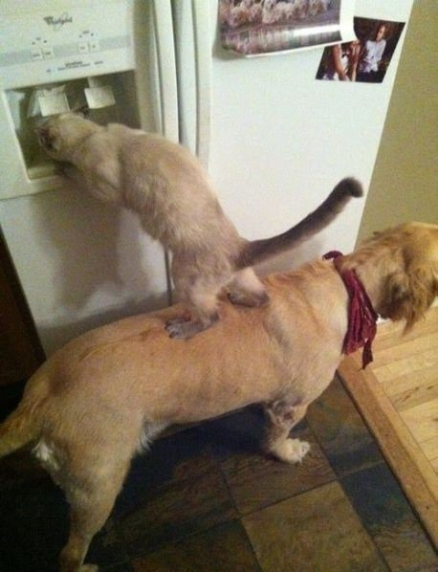
41% of respondents:
collaboration solves problems
2012 edition of the Social Customer Engagement Index, Social Media Today

Slide 19
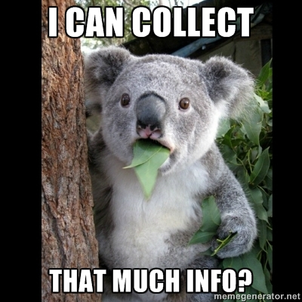

Slide 20
MadCap Pulse Reports
which browsers are being used to view your online output
what people are searching for
what people are searching for and not finding
the number of users who have posted to the system
the most active users
the most liked people
the most commented people
individual user activity
…and so much more

Slide 21
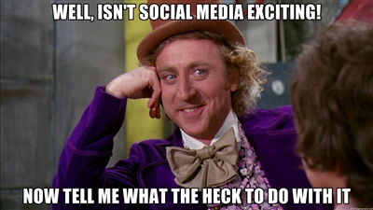

Slide 22
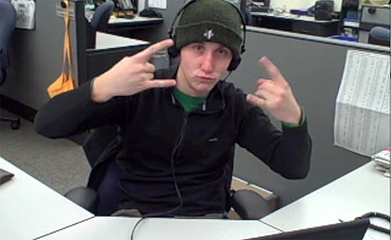
You want Chad the intern
to be the face of your company?!?

Slide 23
Know Your Role(s)
Content Creator
Advocate
Referee
Janitor
Expert
Cheerleader
Troublemaker
Customer Service Rep

Slide 24
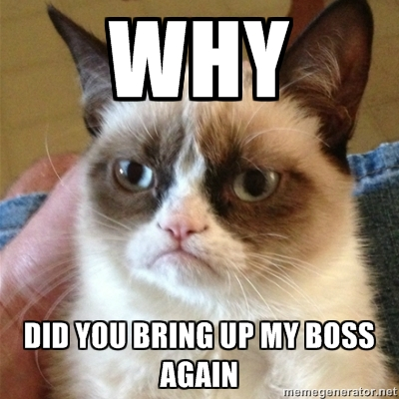

Slide 25
Why should you care?
Your readers care
Your community already exists
Social interaction IS documentation
Hosting your own community is better than letting someone else do it
EVERYONE is watching
Social collaboration solves problems
You can stalk your users

Slide 26
“By 2014, refusing to communicate with customers via social channels will be as harmful as ignoring emails or phone calls is today”
Carol Rozwell, et al. Gartner Report "Business Gets Social: Examples Highlight Adoption Trends and Key Performance Indicators” March 2012

Slide 28
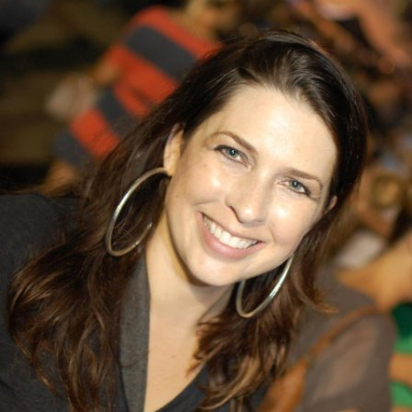
Questions?
Jennifer White
Product Evangelist
MadCap Software
Twitter: @MadCapJennifer
Contact sales with questions or to schedule a demonstration:
Sales@MadCapSoftware.com
Also:
@MadCapSoftware
@MadCapJose
@MadCapDocTeam

