Slide 1
Making Your Content Mobile
Presented by:
Nad Rosenberg
TechWRITE, Inc.
www.techw.com
http://www.techw.com
856-848-6593
twnad@techw.com

Slide 2
About Nad
President and founder (in 1985) of TechWRITE, Inc., a technical communications/e-learning company located in Woodbury, New Jersey, USA
Past President of STC Philadelphia Metro Chapter
STC Associate Fellow
Plain Language Association International Board member and webmaster
www.techw.com
856-848-6593
twnad@techw.com

Slide 3
The Mobile Monster
Smartphone sales surpassed PC sales in 4Q 2011
158.5 million smartphones (up 57 percent from same quarter previous year) compared with 120.2 million PCs.
In 2011, tablet sales grew by 256% to nearly 73 million units
Android activations are 700,000/day
Notes:
Before we begin in earnest, let’s look at some statistics that illustrate the size and growth capacity of the mobile monster.
This year, Smartphone sales will equal PC sales.
There are 300,000 Android activations per day.
By 2014, more than 1 billion information workers will be using smartphones
IDC says that by 2020 there will be 35 billion connected mobile devices.

Slide 4
The Mobile Monster
IDC predicts that by 2020 there will be 35 billion connected mobile devices
Typical mobile knowledge worker accesses mobile device 30 times a day
US consumers were found to spend as much time with mobile media than they do with print magazines and newspapers combined
Notes:
In terms of how often we use these little things, we access them about 30 times a day.
And
US consumers were found to spend as much time with mobile media than they do with print magazines and newspapers combined

Slide 5
Do Mobile Devices = The Invention of the Printing Press?
“It took writers, authors, publishers a while to figure out how to use the press, how to organize information and tell stories in new ways. It took awhile for the format to catch up to the new tools and technology.” Matthew Battles, Harvard historian and librarian
Notes:
The profileration of content on these devices is so great that some people have compared the mobile phenomenon to the invention of the printing press.
Here’s an interesting quote about this from Matthew Battles, a Harvard historian and librarian:
It took writers, authors, publishers a while to figure out how to use the press, how to organize information and tell stories in new ways,” It took awhile for the format to catch up to the new tools and technology.”
And I think some of the same things are happening now.

Slide 6
What Does the Mobile Monster Mean for Us?
Notes:
So what ddoes this mean for technical communicators?

Slide 7
Opportunities and Issues!
HTML
PDF
WebHelp
e-Books
e-Learning
Notes:
The bottom line is that the mobile platform presents a number of i. In this presentation, I will touch on a few of them as they relate to these mobile content platforms:
Mobile apps and web sites
PDF
E-Publs and
E-learning

Slide 8
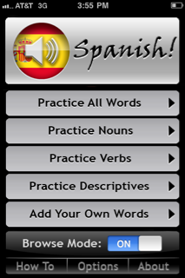
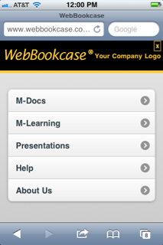
Mobile Apps
Native apps
Mobile web sites
Hybrid
Notes:
Basically there are three types of Apps for mobile devices:
Native Apps – which reside on the device
Mobile Web Sites – which are really internet web sites dressed up in Apps clothing
And a Hybrid fo these two
For the most part, they can all have a similar look and feel.

Slide 9
Mobile Apps
Native apps
Run on the smartphone’s OS
Written in C, C++, Java ME, etc.
Does not need connectivity to work
Can store and retrieve phone data
Can use hardware features like accelerometer, camera, compass
Not portable to other phones
Faster
Notes:
Let’s take a look at the “native app” first. Many people think of this as the real apps.
These apps:
Run on the smartphone’s OS
Written in C, C++, Java ME, etc.
Does not need connectivity to work
Can store and retrieve phone data
Can use hardware features like accelerometer, camera, compass
Not portable to other phones
Faster

Slide 10
Mobile Apps
Mobile web sites
Run inside the smartphone’s browser (even though you often cannot see the browser buttons)
Written in HTML or javascript
Requires connectivity to work
Generally cannot use smartphone’s resources (contacts, calendars, photos) or features (accelerometer, camera, compass)
Notes:
Now let’s look at Mobile web sites, which can be designed to look just like native apps but are really web sites.
Run inside the smartphone’s browser (even though you often cannot see the browser buttons)
Written in HTML or javascript
Requires connectivity to work
Generally cannot use smartphone’s resources (contacts, calendars, photos) or features (accelerometer, camera, compass)

Slide 11
Mobile Apps
Mobile web sites
Can run on other phones
Slower
Hybrid – Combination of app + web content
Notes:
And
Can run on other phones
BUT Slower (3G, 4G or Wifi)

Slide 12
Design Issues
Size matters!
Mobile Device | Resolution (number of distinct pixels in each dimension) | Screen Size (measured diagonally)
iPhone 4 | 960 x 640 | 3.5
Droid X | 854 x 480 | 4.3
iPhone 3GS | 320 x 480 | 3.5
Blackberry 9800 (Torch) | 480 x 360 | 3.18
Blackberry 9650 (Bold) | 480 x 360 | 2.4
iPad 2 | 1024 x 768 | 9.7
Notes:
And mobile is one arena where size does matter. In fact the size of mobile devices is a blessing for users and a curse for designers.
As you can see, there’s considerable difference in size and resolution.

Slide 13
Design Issues
Remember - A mobile device is NOT a PC/Mac so, design for:
Touch
Scrolling and Navigation
Loading speed
On-the-go usage
Notes:
And if size weren’t a big enough problem, you have a variety of other design issues that you have to consider.
Remember that a mobile device is not your mother’s PC. Thinking you can simply shrink your existing web site is not the way to go.
In terms of intended use and ergonomics, mobile devices and PCs are two different animals. So it’s important not to slam your 10 lb PC web site into a 5 lb bag and call it mobile.
Some of the design issues you need to be particularly aware of are:
Touch
Scrolling
Loading speed and
On-the-go usage

Slide 14
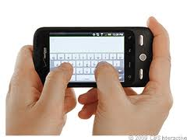
Design Issues - Touch
Tap - To press or select a control or item (analogous to a single mouse click).
Flick – To scroll or pan quickly.
Double-tap – To zoom in and center an image. Double-tap to zoom out.
Notes:
So let’s look at the touch issue first.
Many mobile devices are touch oriented… or at the very least, they’re NOT mouse-driven.
Essentially, these devices are “gesture oriented” and there’s a whole vocabulary of gestures, which as technical communicators we should be aware of
Tap - To press or select a control or item (analogous to a single mouse click).
Flick – To scroll or pan quickly.
Double-tap – To zoom in and center an image. Double-tap to zoom out.

Slide 15
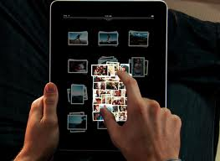
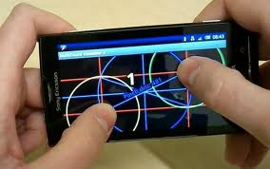
Design Issues - Touch
Pinch open/close – To zoom in/out.
Shake – To initiate or undo an action.
Use the accelerometer – A built-in electronic component that measures tilt and motion (portrait/landscape flip).
Notes:
Pinch open/close – To zoom in/out.
Shake – To initate or undo an action.
Use the acceloromater – A built-in electronic component that measures tilt and motion (portrait/landscape flip). This is what allows your 12-year old to tilt your iPhone when she plays Plants and Zombies.

Slide 16
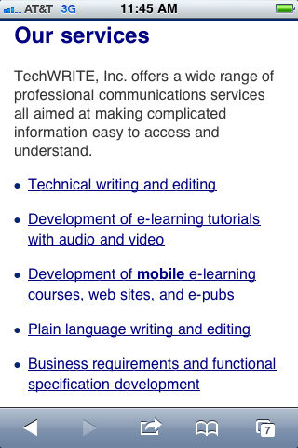
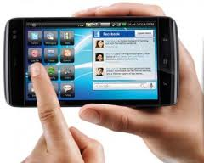
Design Issues - Touch
Tappable elements – Need to be large enough for a finger tap.
Links – Not too close together.
Notes:
Touch functionality has many ramifications for designers.
First of all, icons need to be large enough to accommodate a finger tap. According to Apple, that means 44 points by 44 points. Some of you may be saying to yourselves, where do the “points” come in…I thought the screen sizes were measured in pixels.
Well Steve Jobs and his pals at Apple define points as areas drawn on a screen.
On a standard-resolution device screen (iPhone 3GS), one point equals one pixel. But other resolutions may have a different relationship. On a Retina display, which is what the iPhone 4 is, one point equals two pixels. And of course the bad news here is that in some circumstances, you may need two sets of graphcis, one for standard resolution and one for Retina displays.
Along these same lines, when it comes to links, you have to make sure they’re not too close together…otherwise that giant fingertip might tap the wrong link. For this reason alone, you can see why standard web sites should not be ported directly to mobile.
At the end of this presentation, I’ll give you a list of some site with examples of other ways to navigate.

Slide 17
Design Issues – Loading Speed
Download speed is a big issue.
Reduce the amount, size and complexity of graphics.
Reduce the need to circle through a lot of links.
Notes:
Here’s another issue you need to be aware of – loading speed.
Unless you’re designing for a completely native mobile app, such as a game, your mobile device will probably need to download at least some information from the internet.
As most of you probably know, mobile download speed will depend on many factors, but one thing you can count on is that it probably will not be as fast as on your PC.
This translates into a design issue, specifically the need to reduce the amount, size and complexity of graphics.
Additionally, you’ll want to reduce the need to circle through a lot of links to get to the point.

Slide 18
Design Issues – Navigation and Scrolling
Navigation modes must be different from PC or Mac.
People are used to scrolling on smartphones.
Be sure to test, test, test!
Notes:
Navigation on mobile devices is a whole other ballgame than on PCs or MACs. Because of the issues of physical space and graphics downloading, the typical graphical tabs at the top of the page are not suited for mobile sites.. As we saw earlier, in portrait mode, the mode that most people start using their smart phones in, you just don’t have the real estate to build a long row of tabs. You have to find some other ways to navigate.
Other solutions need to be found. At the end of this presentation, I will give a list of sites where you can see some interesting ideas for different types of navigation.
Another design issue that differs on mobile is scrolling.
On “regular” websites, designers often take pains to limit the need to scroll vertically. This same model does not hold for mobile devices. In the mobile world, people are used to scrolling (albeit using the Flick gesture). That’s because in the mobile environment, to try to fit significant information on one mobile screen might require making the font so small the information is illegible. So don’t jump through hoops to avoid the need to scroll.
And whatever you do, be sure to test, test, test on all types of smartphones and tablets.
Another mobile feature to keep in mind is that users can only see one window at a time. This changes the dynamic somewhat when designing for navigattion

Slide 19
Design Issues – On-the Go-UX
Quick access to required information.
Re-architect your old site to chunk information for mobile.
Not used for long documents.
Searching issue: Reduce need for text entry.
Bottom line: KISS
Notes:
And finally, remember when and where people are pulling out their smart phones… it’s because they’re on-the-go and want to get some piece of information quickly.
Because people interact with mobile devices differently, you may need to look at the architecture of your old PC/Mac web site and restructure it significantly so that information is chunked for mobile.
Nobody want to read a long article on a mobile, in fact company’s are making money from this trend. One of them is a company that’s called Read it Later (http://readitlaterlist.com/) that lets you save articles to read when you have the time and are in a different venue.
Additionally, no one wants to do complicated searches on their smartphones. It’s difficult to enter text on a mobile, so you’ll want to reduce the need for text entry. – so
Keep in mind that people may be holding something else in the other hand while using their mobile phones. People want shortcuts to get them what they need quickly. The bottom line is KISS – Keep It Simple Stupid. The simpler the mobile site or page, the better.

Slide 20
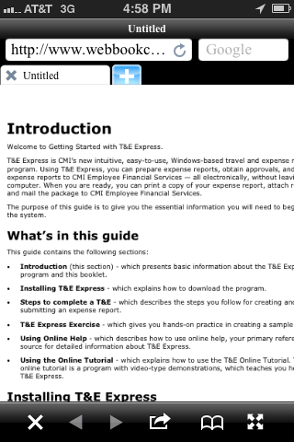
PDF
Sometimes Reader needs to load.
Designed for the printed page.
Type too small to read
Notes:
Let’s now move on to the next type of content platform that’s accessible via mobile devices – PDF.
Basicallly most of the problems of PDF are exacerbated on smart phones, in particular.
Many smartphones come with Readers but if they don’t you have to install the app. On some phones, even when the Reader app is installed, you may have to wait for it to load.
As all of us, who create PDFs on a daily basis know, the genesis of most PDFs is a Word document, which is designed for the printed page. When you access a pdf on a smartphone, typically the type is too small.
In most cases, you have to manually enlarge it and then you have to scroll horizontally to read it.
Additionally, there is no page flow – the top and bottom margins get in the way. So the bottom line here is that PDFs are not well-suited to the smartphone environment.
However, PDFs are easily legible on the iPad, primarily because of the iPad’s larger size and aspect ratio are more similar to the printed page.

Slide 21
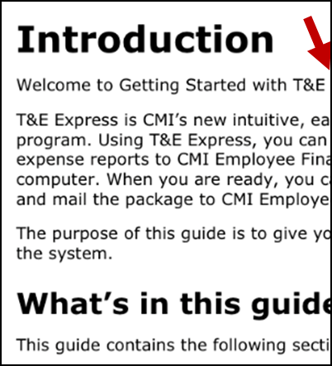
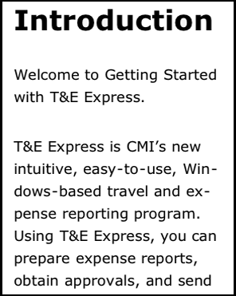
PDF
Enlarging it causes you to scroll horizontally.
No page flow except if you use Reader X but only on Android and iOS devices
Fine on iPad.
Notes:
Let’s now move on to the next type of content platform that’s accessible via mobile devices – PDF.
Basicallly most of the problems of PDF are exacerbated on smart phones, in particular.
Many smartphones come with Readers but if they don’t you have to install the app. On some phones, even when the Reader app is installed, you may have to wait for it to load.
As all of us, who create PDFs on a daily basis know, the genesis of most PDFs is a Word document, which is designed for the printed page. When you access a pdf on a smartphone, typically the type is too small.
In most cases, you have to manually enlarge it and then you have to scroll horizontally to read it.
Additionally, there is no page flow – the top and bottom margins get in the way. So the bottom line here is that PDFs are not well-suited to the smartphone environment.
However, PDFs are easily legible on the iPad, primarily because of the iPad’s larger size and aspect ratio are more similar to the printed page.

Slide 22
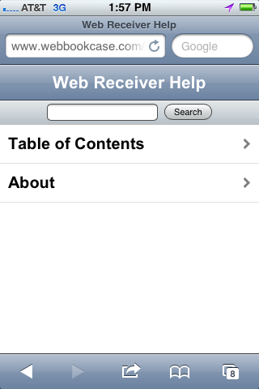
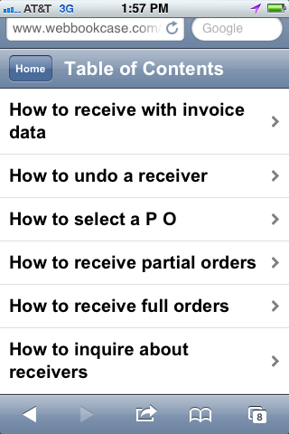
WebHelp
Notes:
Let’s now move on to the next type of content platform that’s accessible via mobile devices – PDF.
Basicallly most of the problems of PDF are exacerbated on smart phones, in particular.
Many smartphones come with Readers but if they don’t you have to install the app. On some phones, even when the Reader app is installed, you may have to wait for it to load.
As all of us, who create PDFs on a daily basis know, the genesis of most PDFs is a Word document, which is designed for the printed page. When you access a pdf on a smartphone, typically the type is too small.
In most cases, you have to manually enlarge it and then you have to scroll horizontally to read it.
Additionally, there is no page flow – the top and bottom margins get in the way. So the bottom line here is that PDFs are not well-suited to the smartphone environment.
However, PDFs are easily legible on the iPad, primarily because of the iPad’s larger size and aspect ratio are more similar to the printed page.

Slide 23
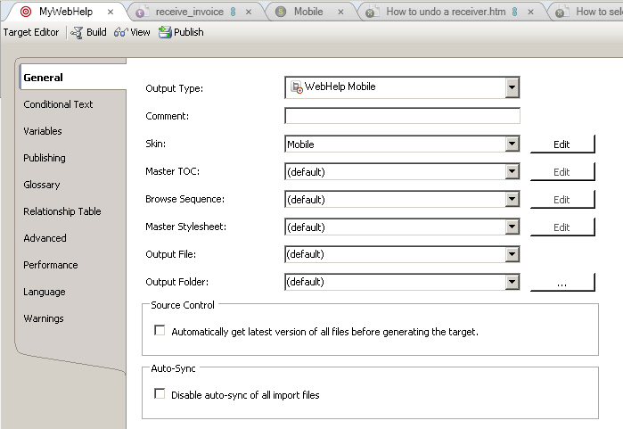
WebHelp
Notes:
Let’s now move on to the next type of content platform that’s accessible via mobile devices – PDF.
Basicallly most of the problems of PDF are exacerbated on smart phones, in particular.
Many smartphones come with Readers but if they don’t you have to install the app. On some phones, even when the Reader app is installed, you may have to wait for it to load.
As all of us, who create PDFs on a daily basis know, the genesis of most PDFs is a Word document, which is designed for the printed page. When you access a pdf on a smartphone, typically the type is too small.
In most cases, you have to manually enlarge it and then you have to scroll horizontally to read it.
Additionally, there is no page flow – the top and bottom margins get in the way. So the bottom line here is that PDFs are not well-suited to the smartphone environment.
However, PDFs are easily legible on the iPad, primarily because of the iPad’s larger size and aspect ratio are more similar to the printed page.

Slide 24
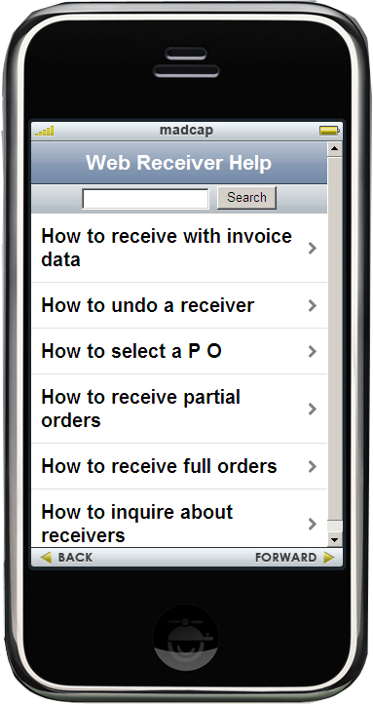
WebHelp
Emulator
Details:
See Neil Perlin’s recorded webinar entitled Going Mobile with Flare Part 2
Caveats:
Only one window at a time on mobile
Watch out for large graphics or tables
Notes:
Let’s now move on to the next type of content platform that’s accessible via mobile devices – PDF.
Basicallly most of the problems of PDF are exacerbated on smart phones, in particular.
Many smartphones come with Readers but if they don’t you have to install the app. On some phones, even when the Reader app is installed, you may have to wait for it to load.
As all of us, who create PDFs on a daily basis know, the genesis of most PDFs is a Word document, which is designed for the printed page. When you access a pdf on a smartphone, typically the type is too small.
In most cases, you have to manually enlarge it and then you have to scroll horizontally to read it.
Additionally, there is no page flow – the top and bottom margins get in the way. So the bottom line here is that PDFs are not well-suited to the smartphone environment.
However, PDFs are easily legible on the iPad, primarily because of the iPad’s larger size and aspect ratio are more similar to the printed page.

Slide 25
e-Books
Exponential growth of e-books.
NYT best seller list has dedicated one whole page for e-book sales.
FAA has authorized iPads to replace the 40 lbs. of reference material pilots carry in their flight bags.
In South Korea, all text books will be replaced by e-books by 2015.
The share of adults in the United States who own an e-book reader doubled to 12% in May, 2011 from 6% in November 2010.
-
Notes:
Another content platform that’s growing exponentially in the mobile world are e-Books. This content platform is growing so rapidly that the venerable New York Times Best Seller List now has a separate list for e-books. The Kindle, the Nook, the Sony Readers…these are among the many hardware devices being sold to accommodate e-books.
Well the reality is that you don’t need any of these devices to read most e-books…they can all be accessed via smartphones or a tablets. And what’s more, you can “roll your own.” And by that I mean, you can create your own e-books, using the open-source e-pub file format.
Readers will need an e-Reader app on their mobile devices to read an their e-pubs but not to worry, there are many free e-Readers on the available. Some of these include Kobo, Stanza, iBooks et.c
The big advantage of e-pubs over pdf is that the text is reflowable. This means the text automatically adjusts itself for legible reading according to the size of the display. It also means that the reader can adjust the size of the text to his or her liking and the entire book readjusts to fit appropriately on the screen. So if the text is a little too small, you can bump it up a bit and all the text in the book will adjust perfectly.
There are no gaps between pages as with PDF and readers typically swipe or tap to move to the next page.
It’s not too hard to create your on e-Pub with this major caveat – as long as its straight running text. If you have a lot of tables or graphics, you’re in for a rough ride…but it can be done. So if you don’t have too much fancy formatting it may be the way to go.

Slide 26
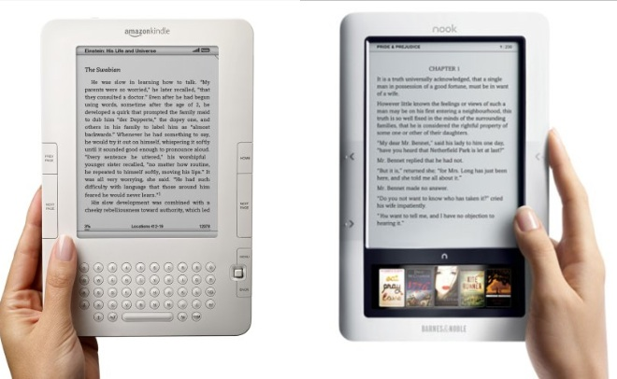
e-Books
Can be read on “dedicated” e-readers or most mobile devices.
If you’re reading on a smartphone or tablet, you need e-Reader software, but there are many free apps available: Kobo, Stanza, Aldiko, iBooks.
February 23, 2012
Notes:
Another content platform that’s growing exponentially in the mobile world are e-Books. This content platform is growing so rapidly that the venerable New York Times Best Seller List now has a separate list for e-books. The Kindle, the Nook, the Sony Readers…these are among the many hardware devices being sold to accommodate e-books.
Well the reality is that you don’t need any of these devices to read most e-books…they can all be accessed via smartphones or a tablets. And what’s more, you can “roll your own.” And by that I mean, you can create your own e-books, using the open-source e-pub file format.
Readers will need an e-Reader app on their mobile devices to read an their e-pubs but not to worry, there are many free e-Readers on the available. Some of these include Kobo, Stanza, iBooks et.c
The big advantage of e-pubs over pdf is that the text is reflowable. This means the text automatically adjusts itself for legible reading according to the size of the display. It also means that the reader can adjust the size of the text to his or her liking and the entire book readjusts to fit appropriately on the screen. So if the text is a little too small, you can bump it up a bit and all the text in the book will adjust perfectly.
There are no gaps between pages as with PDF and readers typically swipe or tap to move to the next page.
It’s not too hard to create your on e-Pub with this major caveat – as long as its straight running text. If you have a lot of tables or graphics, you’re in for a rough ride…but it can be done. So if you don’t have too much fancy formatting it may be the way to go.

Slide 27
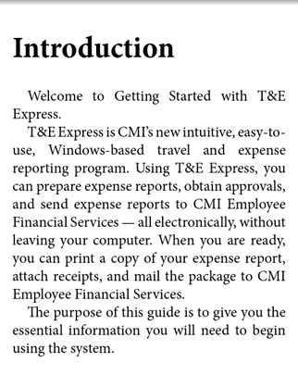
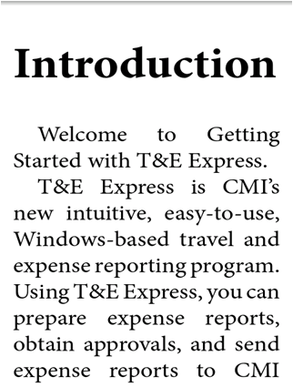
e-Books
Reflowable text that automatically adjusts to fit the device.
But font size can be changed by the (human) reader, and it still reflows.
No gaps between pages.
February 23, 2012
Notes:
Another content platform that’s growing exponentially in the mobile world are e-Books. This content platform is growing so rapidly that the venerable New York Times Best Seller List now has a separate list for e-books. The Kindle, the Nook, the Sony Readers…these are among the many hardware devices being sold to accommodate e-books.
Well the reality is that you don’t need any of these devices to read most e-books…they can all be accessed via smartphones or a tablets. And what’s more, you can “roll your own.” And by that I mean, you can create your own e-books, using the open-source e-pub file format.
Readers will need an e-Reader app on their mobile devices to read an their e-pubs but not to worry, there are many free e-Readers on the available. Some of these include Kobo, Stanza, iBooks et.c
The big advantage of e-pubs over pdf is that the text is reflowable. This means the text automatically adjusts itself for legible reading according to the size of the display. It also means that the reader can adjust the size of the text to his or her liking and the entire book readjusts to fit appropriately on the screen. So if the text is a little too small, you can bump it up a bit and all the text in the book will adjust perfectly.
There are no gaps between pages as with PDF and readers typically swipe or tap to move to the next page.
It’s not too hard to create your on e-Pub with this major caveat – as long as its straight running text. If you have a lot of tables or graphics, you’re in for a rough ride…but it can be done. So if you don’t have too much fancy formatting it may be the way to go.

Slide 28
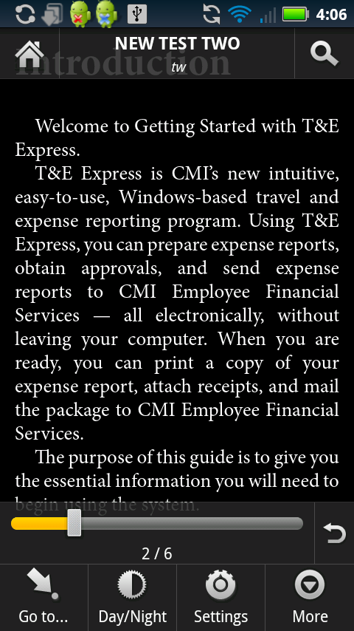
e-Books
No page numbers.
Nice features on many e-Reader apps.
February 23, 2012
Notes:
Another possible minus is that there are no “real” page numbers, which is a result of the flowable text feature. This may or may not matter for you but as a side note, it is causing some problems for Amazon’s Kindle and the Barnes and Noble Nook. Amazon has solved the problem by providing “location numbers.” Barnes and Nobel has solved it by include the page numbers from the printed book.
But on the plus side, most of the free e-Reader apps have many nice features such as Night theme, which turns the type white and the background black, so you can read under the covers or on a plane when they turn off the lights.

Slide 29
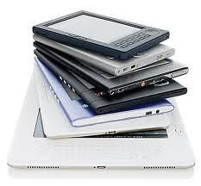
DIY with epubs
epub – open source format, based on html/xhtml.
The industry standard.
A .zip file that contains the necessary files for display on an e-reader.
Supported by all major e-readers except Amazon’s Kindle until recently but that is going to change.
Other formats: .mobi, .prc, .azw
February 23, 2012
Notes:
It’s not too hard to create your own e-Pub with this major caveat – as long as its straight running text. If you have a lot of tables or graphics, you’re in for more complexity on the development side…in other words you should have a good understanding of HTML coding because you will need to do a lot of tweaking. Bottom line: If you don’t have too much fancy formatting it may be the way to go.
The most popular piece of e-book conversion software is called Calibre …. I’ll provide the link on the final slide.
Another possible minus is that there are no “real” page numbers, which is a result of the flowable text feature. This may or may not matter for you but as a side note, it is causing some problems for Amazon’s Kindle and the Barnes and Noble Nook. Amazon has solved the problem by providing “location numbers.” Barnes and Nobel has solved it by include the page numbers from the printed book.
One other thing to mention – Most of the free e-Reader apps have many nice features such as night theme

Slide 30
DIY with epubs: What You Need
Source document
HTML is best but possible to do it with .pdf or .txt (not recommended).
Conversion software
Calibre (FREE) with Sigil (FREE)
Adobe InDesign (NOT FREE)
Caveats
Works best with straight running text.
If complicated formatting, HTML knowledge helps
More Info?
blog.techw.com
Notes:
It’s not too hard to create your own e-Pub with this major caveat – as long as its straight running text. If you have a lot of tables or graphics, you’re in for more complexity on the development side…in other words you should have a good understanding of HTML coding because you will need to do a lot of tweaking. Bottom line: If you don’t have too much fancy formatting it may be the way to go.
The most popular piece of e-book conversion software is called Calibre …. I’ll provide the link on the final slide.
Another possible minus is that there are no “real” page numbers, which is a result of the flowable text feature. This may or may not matter for you but as a side note, it is causing some problems for Amazon’s Kindle and the Barnes and Noble Nook. Amazon has solved the problem by providing “location numbers.” Barnes and Nobel has solved it by include the page numbers from the printed book.
One other thing to mention – Most of the free e-Reader apps have many nice features such as night theme

Slide 31
e-Learning
No Flash on iPhone or iPad
Adobe will stop supporting Flash in mobile browsers.
Focus will change to HTML5.
As yet, HTML5 no match for Flash but that will change
As yet, not all browsers support HTML5 (the following DO support HTML5: IE8, Safari, Chrome, Firefox, and IE8)
Notes:
The final content area I’m going to discuss today is e-Learning.
Perhaps the first thing to know about creating e-learning tutorials for mobile devices is that Apple has determined that “Thou shall not see any Flash on the iPhone or iPad.” They say HTML5 is the answer…but HTML5 is still a shifting standard.
This is a big problem for those of us who spent billions of hours creating e-learning tutorials in Flash. The good news is that Flash works fine on the Android and other devices so we are not totally sunk. And the other good news is that more and more smartphones and tablets are being introduced which do allow Flash – so maybe Apple will have to give in…or maybe not.
And I recently just read (like yesterday) that Adobe has announced a new technology called Wallaby that will convert Flash into HTML5 so I am very eager to try this.
The other piece of quasi-bad news is that, Just as with web site paradigm, you can’t simply take your e-learning tutorials and shrink them down a little and plunk them onto a mobile device. When I say “you can’t” I really mean is “you shouldn’t.”
Basically, you’re going to have to resize your project and that includes such items as graphics, captions

Slide 32
e-Learning
So what’s an e-learning developer to do?
Convert to .mp4
Convert to HTML5
Keep producing Flash
OnLive Desktop
Notes:
The final content area I’m going to discuss today is e-Learning.
Perhaps the first thing to know about creating e-learning tutorials for mobile devices is that Apple has determined that “Thou shall not see any Flash on the iPhone or iPad.” They say HTML5 is the answer…but HTML5 is still a shifting standard.
This is a big problem for those of us who spent billions of hours creating e-learning tutorials in Flash. The good news is that Flash works fine on the Android and other devices so we are not totally sunk. And the other good news is that more and more smartphones and tablets are being introduced which do allow Flash – so maybe Apple will have to give in…or maybe not.
And I recently just read (like yesterday) that Adobe has announced a new technology called Wallaby that will convert Flash into HTML5 so I am very eager to try this.
The other piece of quasi-bad news is that, Just as with web site paradigm, you can’t simply take your e-learning tutorials and shrink them down a little and plunk them onto a mobile device. When I say “you can’t” I really mean is “you shouldn’t.”
Basically, you’re going to have to resize your project and that includes such items as graphics, captions

Slide 33
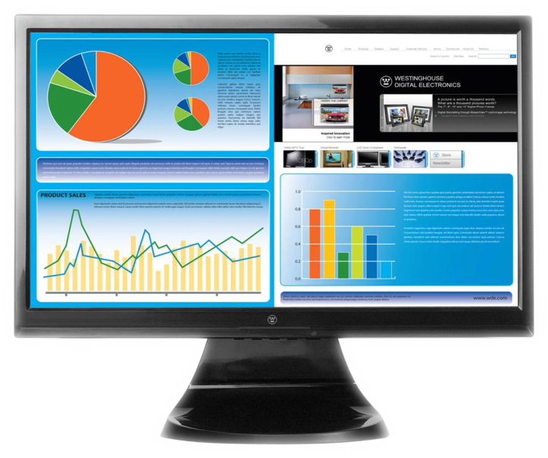
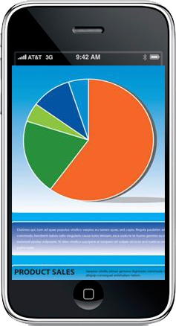
e-Learning
Can’t simply shrink PC/Mac-based e-learning tutorials.
Need to re-size graphics and captions.
Notes:
The final content area I’m going to discuss today is e-Learning.
Perhaps the first thing to know about creating e-learning tutorials for mobile devices is that Apple has determined that “Thou shall not see any Flash on the iPhone or iPad.” They say HTML5 is the answer…but HTML5 is still a shifting standard.
This is a big problem for those of us who spent billions of hours creating e-learning tutorials in Flash. The good news is that Flash works fine on the Android and other devices so we are not totally sunk. And the other good news is that more and more smartphones and tablets are being introduced which do allow Flash – so maybe Apple will have to give in…or maybe not.
And I recently just read (like yesterday) that Adobe has announced a new technology called Wallaby that will convert Flash into HTML5 so I am very eager to try this.
The other piece of quasi-bad news is that, Just as with web site paradigm, you can’t simply take your e-learning tutorials and shrink them down a little and plunk them onto a mobile device. When I say “you can’t” I really mean is “you shouldn’t.”
Basically, you’re going to have to resize your project and that includes such items as graphics, captions

Slide 34
e-Learning
Controls need to be larger.
Notes:
and especially controls…because remember people will be tapping on the controls with their fingers.
But perhaps the most important difference between creating e-learning tutorials for mobile devices is that you have to make them short and to the point. People typically take tutorials when they are on the go, waiting at the airport, on the train, waiting for a meeting and nobody is going to sit there for an hour slogging through a long tutorial.

Slide 35
e-Learning
Keep is short and to the point!
No one wants to slog through a long tutorial on a smartphone!
Notes:
and especially controls…because remember people will be tapping on the controls with their fingers.
But perhaps the most important difference between creating e-learning tutorials for mobile devices is that you have to make them short and to the point. People typically take tutorials when they are on the go, waiting at the airport, on the train, waiting for a meeting and nobody is going to sit there for an hour slogging through a long tutorial.

Slide 36
Performance Support
Information people turn to on the job when they’re:
Unsure about what to do or
Need reminders or
They’re looking for a solution to a problem.
Notes:
Let’s now move on to the next type of content platform that’s accessible via mobile devices – PDF.
Basicallly most of the problems of PDF are exacerbated on smart phones, in particular.
Many smartphones come with Readers but if they don’t you have to install the app. On some phones, even when the Reader app is installed, you may have to wait for it to load.
As all of us, who create PDFs on a daily basis know, the genesis of most PDFs is a Word document, which is designed for the printed page. When you access a pdf on a smartphone, typically the type is too small.
In most cases, you have to manually enlarge it and then you have to scroll horizontally to read it.
Additionally, there is no page flow – the top and bottom margins get in the way. So the bottom line here is that PDFs are not well-suited to the smartphone environment.
However, PDFs are easily legible on the iPad, primarily because of the iPad’s larger size and aspect ratio are more similar to the printed page.

Slide 37
Performance Support
Short
Easily comprehensible
Easily accessible
Perfect fit for mobile
Notes:
Let’s now move on to the next type of content platform that’s accessible via mobile devices – PDF.
Basicallly most of the problems of PDF are exacerbated on smart phones, in particular.
Many smartphones come with Readers but if they don’t you have to install the app. On some phones, even when the Reader app is installed, you may have to wait for it to load.
As all of us, who create PDFs on a daily basis know, the genesis of most PDFs is a Word document, which is designed for the printed page. When you access a pdf on a smartphone, typically the type is too small.
In most cases, you have to manually enlarge it and then you have to scroll horizontally to read it.
Additionally, there is no page flow – the top and bottom margins get in the way. So the bottom line here is that PDFs are not well-suited to the smartphone environment.
However, PDFs are easily legible on the iPad, primarily because of the iPad’s larger size and aspect ratio are more similar to the printed page.

Slide 38
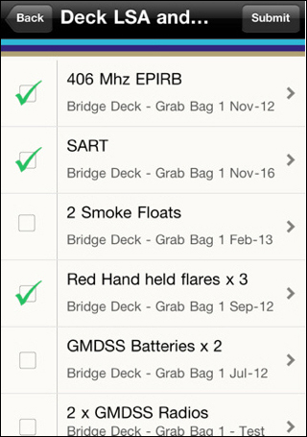
Performance Support
Quick reference cards, job aids, help cards
Notes:
Let’s now move on to the next type of content platform that’s accessible via mobile devices – PDF.
Basicallly most of the problems of PDF are exacerbated on smart phones, in particular.
Many smartphones come with Readers but if they don’t you have to install the app. On some phones, even when the Reader app is installed, you may have to wait for it to load.
As all of us, who create PDFs on a daily basis know, the genesis of most PDFs is a Word document, which is designed for the printed page. When you access a pdf on a smartphone, typically the type is too small.
In most cases, you have to manually enlarge it and then you have to scroll horizontally to read it.
Additionally, there is no page flow – the top and bottom margins get in the way. So the bottom line here is that PDFs are not well-suited to the smartphone environment.
However, PDFs are easily legible on the iPad, primarily because of the iPad’s larger size and aspect ratio are more similar to the printed page.

Slide 39
WebHelp to Performance Support
Notes:
Let’s now move on to the next type of content platform that’s accessible via mobile devices – PDF.
Basicallly most of the problems of PDF are exacerbated on smart phones, in particular.
Many smartphones come with Readers but if they don’t you have to install the app. On some phones, even when the Reader app is installed, you may have to wait for it to load.
As all of us, who create PDFs on a daily basis know, the genesis of most PDFs is a Word document, which is designed for the printed page. When you access a pdf on a smartphone, typically the type is too small.
In most cases, you have to manually enlarge it and then you have to scroll horizontally to read it.
Additionally, there is no page flow – the top and bottom margins get in the way. So the bottom line here is that PDFs are not well-suited to the smartphone environment.
However, PDFs are easily legible on the iPad, primarily because of the iPad’s larger size and aspect ratio are more similar to the printed page.

Slide 40
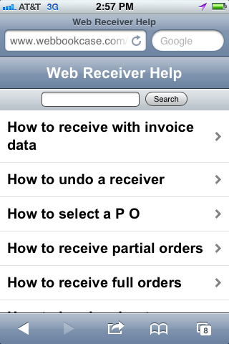
WebHelp to Performance Support
Notes:
Let’s now move on to the next type of content platform that’s accessible via mobile devices – PDF.
Basicallly most of the problems of PDF are exacerbated on smart phones, in particular.
Many smartphones come with Readers but if they don’t you have to install the app. On some phones, even when the Reader app is installed, you may have to wait for it to load.
As all of us, who create PDFs on a daily basis know, the genesis of most PDFs is a Word document, which is designed for the printed page. When you access a pdf on a smartphone, typically the type is too small.
In most cases, you have to manually enlarge it and then you have to scroll horizontally to read it.
Additionally, there is no page flow – the top and bottom margins get in the way. So the bottom line here is that PDFs are not well-suited to the smartphone environment.
However, PDFs are easily legible on the iPad, primarily because of the iPad’s larger size and aspect ratio are more similar to the printed page.

Slide 41
Taming the mobile monster
Notes:
In terms of how often we use these little things, we access them about 30 times a day.
And
US consumers were found to spend as much time with mobile media than they do with print magazines and newspapers combined

Slide 42
For More Information:
Examples of mobile web sites
http://www.mobileawesomeness.com
http://iphone.appstorm.net/roundups/design/30-gorgeous-iphone-optimized-websites/
MadCap Flare WebHelp Mobile to Performance Support Trick
http://www.madcapsoftware.com/blog/2012/02/09/webhelp-mobile-as-a-mobile-performance-support-application/
Emulators
http://mtld.mobi/emulator.php
http://www.testiphone.com/
http://www.opera.com/developer/tools/mini/
http://mobiforge.com/emulators/page/mobile-emulators
http://www.mobilephoneemulator.com/
http://ipadpeek.com/
http://www.adobe.com/products/devicecentral.html
http://tmobile.modeaondemand.com/htc/g1/
http://iphonetester.com/
http://www.mobilemoxie.com/handset-emulators/phone-emulator/
http://whatsonmypc.wordpress.com/2010/03/21/tryphone/

Slide 43
For More Information:
Flash and HTML5
http://blog.techw.com/
Five things you can’t do with HTML5 (yet)
http://blogs.msdn.com/b/thebeebs/archive/2011/12/04/five-things-you-can-t-
do-with-html5-yet.aspx
Examples of .swf converted to HTML5 http://www.facebook.com/adobecaptivate?sk=app_303058359733981
OnLive Desktop
http://desktop.onlive.com/overview
Make your own mobile apps
MadCap Flare – http://www.madcapsoftware.com/
MobiFlex - http://www.viziapps.com/LearnMore.aspx
17 Solutions to build your own mobile app - http://www.practicalecommerce.com/ articles/2573-17-Solutions-to-Build-Your-Own-Mobile-App/page/2

Slide 44
For More Information about TechWRITE:
Go to TechWRITE’s web site: http://www.techw.com
Contact Nad at TechWRITE at: twnad@techw.com 856-848-6593

