Slide 3
About ISO 13485
What is ISO 13485?
ISO — International Organization of Standards
Medical devices — Quality management systems — Requirements for regulatory purposes
Analogous to ISO 9001 – general standard for quality management systems
Provides framework for establishing a quality management system for medical device manufacture
Standard applies to any organization involved in the following for medical devices:
Design and development
Production
Storage and distribution
Installation and service

Slide 4
ISO 13485 vs. 9001
What are the differences between 13485 and 9001
Both are Quality System Management standards
9001 is…
More generic
Allows more flexibility
Can be applied to any organization
13485 is…
Specific to medical device
Puts patient/consumer safety at the center of the standard
Requires increased documentation
Requires greater traceability in production
VS.

Slide 5
Criticality of Translation
Why is translation so important for medical devices?
PATIENT SAFETY!!!
High-quality instructions, safety guidelines, settings, dosages, exposure, etc.
Liability for the manufacturer
How does translation impact patient/consumer safety?
Incomplete translation
Inaccurate translation
Wrong terminology
Factual imprecision
Ambiguous or misleading
Inconsistent terminology
Anything that leads to improper or inconsistent use of a medical device that results in hard to the patient/consumer
Notes:
Traceability and change management – segment level
Managing liability
Versioning

Slide 6
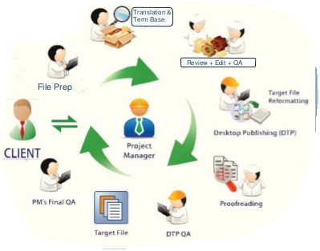
ISO 13485 and the translation process
How does the ISO 13485 standard affect translation?
The standard requires traceability
Who did what when, so that errors can be traced and corrected
This is an important liability issue for clients and providers
It also raises the profile of change management and versioning in the document authoring and translation processes
Notes:
Traceability and change management – segment level
Managing liability
Versioning

Slide 7
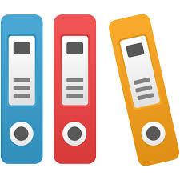
3.8 Labelling
“Labelling” refers to all information that appears on or is disseminated with the product.
Labels
Instructions for use (IFUs)
Any information related to…
Identification
Technical description
Intended purpose
Proper use of the medical device
Excludes shipping documents
Best quality assurance for translated content: high-quality source content
Create content with patient safety at the center
Use translation/localization as a “stress test” for your content.
Single-source authoring to improve control, minimize effort.
Notes:
Single-source
Content creation and patient safety
Over 13485, translation as source quality control—localization as stress test. Head nod vs. shake

Slide 8
4.1.5 Control Outsourcing
Use must monitor and control outsourced processes
Controls must be proportionate to the risk involved
Best level of control is having an ISO-certified vendor
Avoids burdensome auditing by your company
Sets clear requirements for vendor
Reduces your liability by enforcing traceability
Document that you are relying on ISO 13485 vendor certification as part of your quality management
Include vendors ISO certificate in your documentation

Slide 9
7.5.1 Control of production and service provider
“Production and service provision shall be planned, carried out, monitored and controlled to ensure that product conforms to specification. As appropriate, production controls shall include but are not limited to:
…
e) implementation of defined operations for labelling and packaging;…”
If relying on ISO-certification of your vendor, you will only need to document your internal processes around authoring and content management.

Slide 10
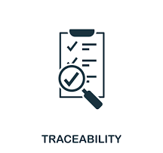
7.5.9 Traceability
Traceability, or the act of tracking activities that affect production of a product is a core ISO 13485 requirement
Section 7.5.10 Customer property – requires that customer materials be safeguarded
Customer property that unsuitable for use must be report to the customer

Slide 11
How is traceability achieved during translation?
Well-equipped translation providers can trace translation activity down to a deep level.
Process steps and related workers are all tracked

Slide 12
How is traceability achieved during translation?
Within the translation environment, activity is traceable to the segment (sentence) level of the content.

Slide 13
ISO 13485 and MadTranslations
To achieve 13485 certication, MadTranslations had to undergo:
Pre-audit ISO 9001 QS to identify gaps
Enact recommendations to enhance existing QS
Conduct internal audits
Create more documentation
Purchasing
Job descriptions
Task/Work instructions
Notes:
Pre-audit, stage 1 audit
Pre-scan, recommendations to enhance/add over 9000
Internal audits, increase level documentation, software purchases, job descriptions, task instructions
Stage 2 audit certification audit

Slide 14
MDR (Medical Device Regulation)
Regulation of the EU Parliament that governs market entry of medical devices into European Union member countries
Addresses concerns over assessment of product safety and performance
Stricter requirements for
Clinical evaluation
Post-market clinical follow-up
Supply chain traceability of product
Greater scrutiny of documentation
Deadline extended from May 26, 2020 to 2021 due to COVID-19 pandemic
Notes:
What is it and the current status?
Apps that are medical devices.

