Slide 3
Eva Reiterer
Localization Consultant at MadTranslations
based in Austria, Europe
specialised in supporting clients with
centralizing localization purchasing processes
designing value adding internationalization strategies
reducing legal risks
Renowned speaker in the localization industry
TcWorld Germany / Austria / China

Slide 4
Agenda
Data protection vs. data security
Free MT tools and their risk
How to evaluate providers
Further aspects of data security
How to protect your data – summary
Q&A

Slide 5
Data protection vs. Data security

Slide 6
Data protection vs. Data security
Data Protection (GDPR)
Data security
= EU law which regulates the transfer of personal data („Data privacy / Data protection“)
Applies to any enterprise that is processing the personal information of individuals inside the EEA
How to protect data from unauthorized access, through process design or technology
Regulated through ISO 27000 standards / SOC levels

Slide 7
Free MT tools and their risks

Slide 8
3-5 GB
is the amount of enterprise data that was cut and pasted per day into free, public MT tools at major US semiconductor company.
The data included, among other, future product plans, sensitive HR issues, customer problem related communication.
Source
Notes:
https://www.rws.com/blog/The-Issue-of-Data-Security-and-Machine-Translation/

Slide 9
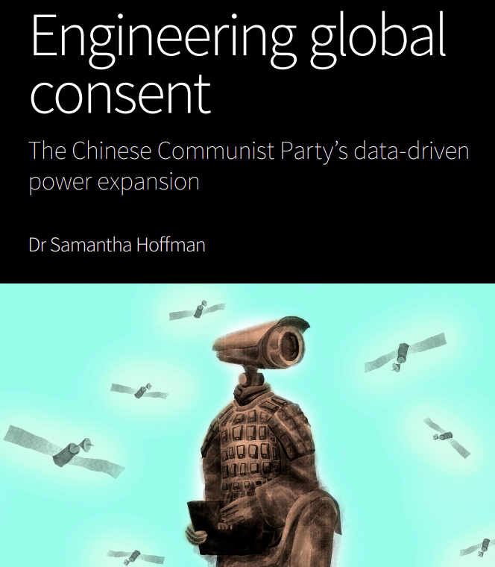
Machine translation and espionage?
Report from Australian Strategic Policy Institute (ASPI) makes some claims about how China uses state-owned companies to collect global data.
Machine Translation provider GTCOM (subsidiary of a state-owned company) is estimated to handle more than 5 trillion words per day, across 65 languages.
Source
Notes:
A recent report from the Australian Strategic Policy Institute (ASPI) makes some claims about how China uses state-owned companies, which provide machine translation services, to collect data on users outside China. The author, Samantha Hoffman, argues that the most valuable tools in China’s data-collection campaign are technologies that users engage with for their own benefit; machine translation services being a prime example. This is done through a company called GTCOM, which Hoffman said describes itself as a “cross-language big data” business, offers hardware and software translation tools that collect data — lots of data. She estimated that GTCOM, which works with both corporate and government clients, handles the equivalent of up to five trillion words of plain text per day, across 65 languages and in over 200 countries. GTCOM is a subsidiary of a Chinese state-owned enterprise that the Central Propaganda Department directly supervises, and thus data collection is presumed to be an active and ongoing process.

Slide 10
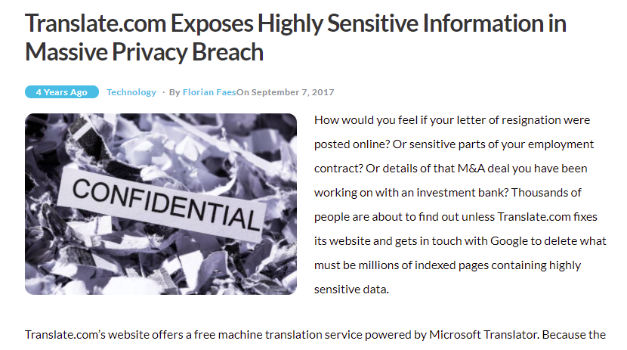
What could go wrong?
Justification by Translate.com:
“there was a clear note on our homepage stating: ‘All translations will be sent to our community to improve accuracy’ and that ‘some of these requests were indexed by search engines such as Google and Microsoft at that time.’”
Fine print of Terms & Conditions stating that while they “will use reasonable measures to protect any content you provide to us for the purpose of completing the Services,” they “cannot and do not guarantee that any information provided to us by you will not become public under any circumstances. You should appreciate that all information submitted on the website might potentially be publicly accessible.”
Source
Notes:
The massive privacy breach was first uncovered on September 3, 2017 by Norwegian news agency NRK, which reported that employees of state-run oil giant Statoil had “discovered text that had been typed in on [Translate.com] could be found by anyone conducting a [Google] search.” Their reaction: “Wow, what is this?”
“plans of workforce reductions and outsourcing, passwords, code information, and contracts”
physician’s email exchange with a global pharmaceutical company on tax matters, late payment notices, a staff performance report of a global investment bank, and termination letters. In all instances, full names, emails, phone numbers, and other highly sensitive data were revealed.

Slide 11
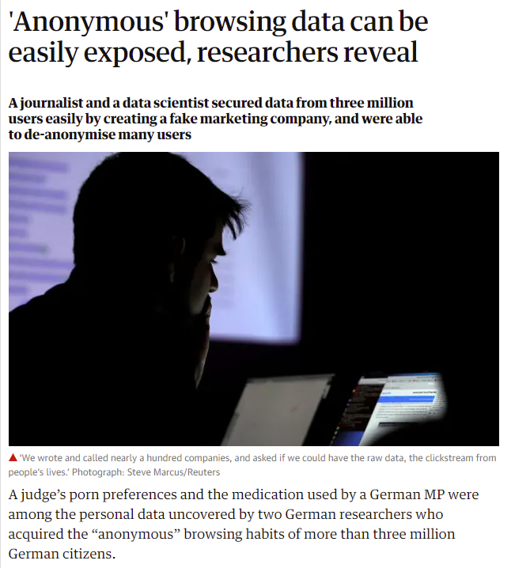
What could go wrong?
Hacking Conference DEFCON in 2017
Presenters showed how easy it is to de-anonymize users and track their use of MT tools.
Full details of an ongoing cyber security police investigation were uncovered, including names, addresses and other sensitive information – because the German detective had used the free version of Google Translate to communicate with foreign police forces.
Source – Video (ab Minute 24)

Slide 12
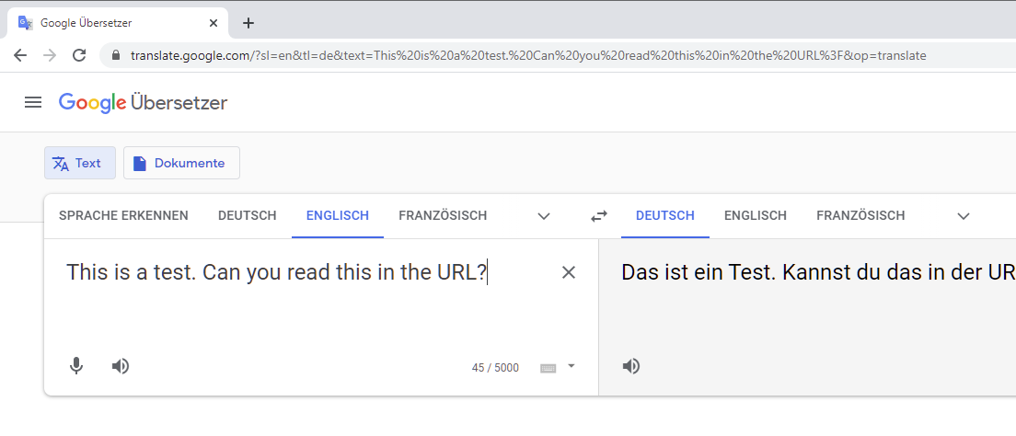
Date of screenshot: 25 May 2021

Slide 13
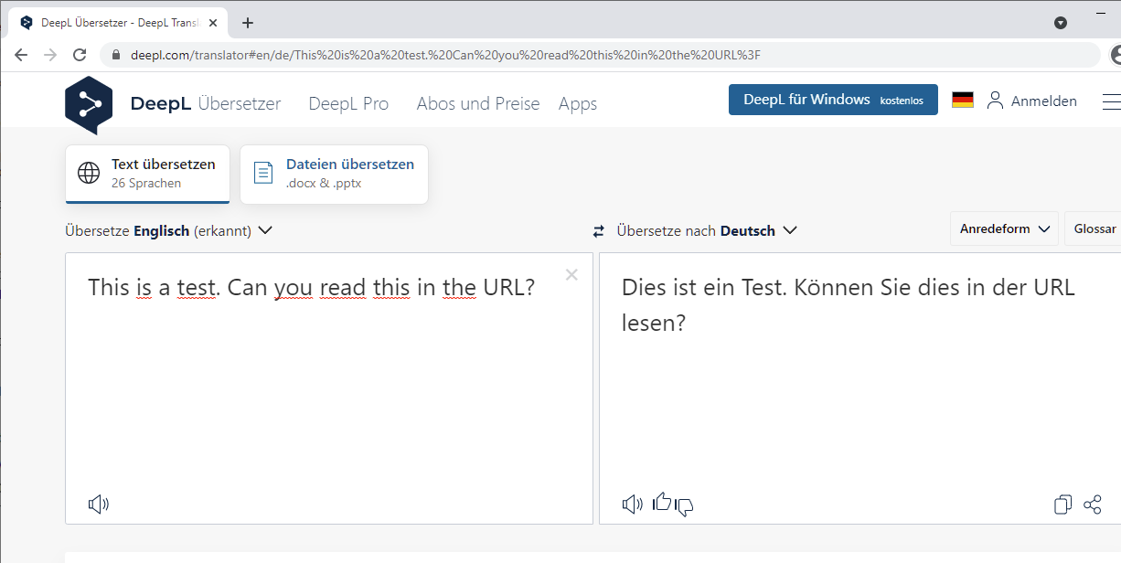
Date of screenshot: 25 May 2021

Slide 14
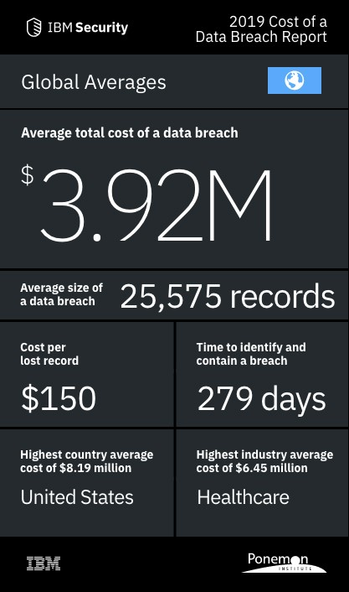
SOCIAL HACKING
Notes:
Radware estimates that an average cyber-attack in 2018 costs an enterprise around $1.67M. The costs can be significantly higher, e.g. a breach at Maersk is estimated to have cost around $250 - $300 million, because of the brand damage, loss of productivity, loss of profitability, falling stock prices, and other negative business impacts in the wake of the breach.
Risk Based Security reports that there were over 6500 data breaches and that more than 5 billion records were exposed in 2018. The situation is not better in 2019, and over 4 billion records were exposed in the first six months of 2019.
An IBM Security study revealed that the financial impact of data breaches on organizations. According to this study, the cost of a data breach has risen 12% over the past 5 years and now costs $3.92 million on average. The average cost of a data breach in the U.S. is $8.19 million, more than double the worldwide average.

Slide 15
Google Translate (free version)
What do the terms and conditions say?
Your content remains yours, which means that you retain any intellectual property rights that you have in your content.
This license covers your content if that content is protected by intellectual property rights. This license is:
worldwide, which means it’s valid anywhere in the world
non-exclusive, which means you can license your content to others
royalty-free, which means there are no fees for this license
This license allows Google to:
host, reproduce, distribute, communicate, and use your content — for example, to save your content on our systems and make it accessible from anywhere you go
publish, publicly perform, or publicly display your content, if you’ve made it visible to others
modify your content, such as reformatting or translating it
sublicense these rights to:
other users to allow the services to work as designed, such as enabling you to share photos with people you choose
our contractors who’ve signed agreements with us that are consistent with these terms, only for the limited purposes described in the Purpose section below
https://policies.google.com/terms?hl=en#footnote-intellectual-property-rights
Notes:
Texte pseudonymisieren und anonymisieren
Als Google User kann Google auch die Suchanfragen in Google Translate mit einzelnen Usern in Verbindung bringen

Slide 16
Google Translate (free version)
What do the terms and conditions say?
Your content remains yours, which means that you retain any intellectual property rights that you have in your content.
This license covers your content if that content is protected by intellectual property rights. This license is:
worldwide, which means it’s valid anywhere in the world
non-exclusive, which means you can license your content to others
royalty-free, which means there are no fees for this license
This license allows Google to:
host, reproduce, distribute, communicate, and use your content — for example, to save your content on our systems and make it accessible from anywhere you go
publish, publicly perform, or publicly display your content, if you’ve made it visible to others
modify your content, such as reformatting or translating it
sublicense these rights to:
other users to allow the services to work as designed, such as enabling you to share photos with people you choose
our contractors who’ve signed agreements with us that are consistent with these terms, only for the limited purposes described in the Purpose section below
Aktuell kein Leak bekannt
No data leak known of at this time
Im Falle eines Leaks kaum bis kein rechtlicher Handlungsspielraum, weil jeder Nutzer Google zustimmt, dass Google die Inhalte weiterverwenden kann.
Restricted legal scope for action in case of damage
Niemals personenbezogene Daten oder vertrauliche Informationen in Google Translate eingeben.
Sicherheitslücke: Textinhalt in der URL
Never use it for translating sensitive information
Known security risk: text in the URL
https://policies.google.com/terms?hl=en#footnote-intellectual-property-rights
Notes:
Texte pseudonymisieren und anonymisieren
Als Google User kann Google auch die Suchanfragen in Google Translate mit einzelnen Usern in Verbindung bringen

Slide 17
DeepL (free version)
What do the terms and conditions say?
When using our translation service, please only enter texts that you wish to transfer to our servers. The transmission of these texts is necessary in order for us to provide the translation and offer you our service.
We process your texts, the documents you upload and their translations for a limited period of time to train and improve our neural networks and translation algorithms.
If you make corrections to our proposed translations, these corrections are also forwarded to our servers to verify the accuracy of the corrections and, if necessary, to update the translated text to reflect your changes. We also store your corrections for a limited period of time to train and improve our translation algorithm.
Please note that using our translation service for texts containing personal data of any kind is not allowed.
https://www.deepl.com/en/privacy/

Slide 18
DeepL (free version)
What do the terms and conditions say?
When using our translation service, please only enter texts that you wish to transfer to our servers. The transmission of these texts is necessary in order for us to provide the translation and offer you our service.
We process your texts, the documents you upload and their translations for a limited period of time to train and improve our neural networks and translation algorithms.
If you make corrections to our proposed translations, these corrections are also forwarded to our servers to verify the accuracy of the corrections and, if necessary, to update the translated text to reflect your changes. We also store your corrections for a limited period of time to train and improve our translation algorithm.
Please note that using our translation service for texts containing personal data of any kind is not allowed.
No data leak known of at this time
Restricted legal scope for action in case of damage
Never use it for translating sensitive information
Known security risk: text in the URL
https://www.deepl.com/en/privacy/

Slide 19
How to use free mt tools
Tips for creating a machine translation policy
Individual words
Sentences without traceable information
Information which will be published online
Anonymized / pseudonymized non-confidential information
Unadjusted sentences or paragraphs
Entire documents
Text containing confidential data
Text containing personal data
In conclusion:
Not blocking access to free MT tools in an enterprise is only justifiable if policies, employee training and regular control measures are strong enough.
Notes:
Um Haftungsfällen vorzubeugen, im ganzen Unternehmen die Verwendung kostenloser Übersetzungstools sperren.
Dadurch kann im Fall eines Leaks von vertraulichen Informationen zumindest diese Ursache ausgeschlossen werden.
Beim Kauf von DeepL Pro kann eingestellt werden, dass alle Anfragen von gewissen IP-Adressen wenn sie auf die DeepL Seite gehen, automatisch zur unternehmensspezifischen Pro-Version kommen, ohne erforderlichen Login.

Slide 20
How to evaluate providers

Slide 21
Data Protection
Data Security
If personal data is to be processed:
Conclude a data processing agreement with the provider
Check for server location
Check terms and conditions for clauses about personal data
If confidential data is to be processed:
Choose a provider who is
ISO 27001 or SOC 2 certified and
doesn‘t have any conflicts of interest (such as industry espionage)
Check terms and conditions for
ownership of data and
further processing your data for other clients / products

Slide 22
Examples of paid mt providers
A peak into their terms and conditions
DeepL Pro
Amazon Translate
ISO 27001 certified
T&C: „DeepL will only store Content or Processed Content on its servers to the extent technically required to provide its services. Content or Processed Content will neither be perpetually stored on DeepL’s servers nor returned to Customer.”
T&C: „DeepL will use the Customer Training Data exclusively in connection with the translations of the respective Customer and will store and process it for the term of the Agreement in such a way that no unauthorised persons have access to it.”
Numerous certifications
T&C: ”(a) we may use and store AI Content that is processed by each of the foregoing AI Services to maintain and provide the applicable AI Service (including development and improvement of such AI Service)”
FAQs: You may opt out of having your content used to improve and develop the quality of Amazon Translate and other Amazon machine-learning/artificial-intelligence technologies by using an AWS Organizations opt-out policy.
FAQs: You always retain ownership of your content, and we will only use your content with your consent.

Slide 23
Examples of paid mt providers
A peak into their terms and conditions
Modern MT
Google AutoML
ISO 27001 certified
T&C: „ModernMT does not acquire ownership in your API Clients, and by using our APIs, you do not acquire ownership of any rights in our APIs or the content that is accessed through our APIs.”
Website: „When using one of these paid services, we don't use your texts to improve the quality of the baseline engine, or other clients’ engines”
(Little information beyond the above)
Numerous certifications
Comprehensive information about data security measures
„you own your data, and we will never use it for any purpose other than those necessary to fulfill our contractual/legal obligations“
Notes:
Google – nur ein schlechter Ruf?
Nachteil von Google – umständlich und sehr kompliziert in Bedienung, Termdatenbank hochladen erfordert teilweise Programmierkenntnisse

Slide 24
Examples of paid mt providers
A peak into their terms and conditions
Intento
Microsoft Translator
ISO 27001 certified
T&C: “Please note that Intento does not receive any rights in any information or data from your accounts with third party services that is passed through or is processed by Intento, unless you choose to make it publically available on Intento.”
Website: “We guarantee that you can translate content safely without caching on third-party servers or exposing confidential data.”
T&C: “By uploading content to Intento, you are effectively transfering ownership of that content to us. We may moderate this content or remove it at our discretion.”
Numerous certifications
T&C: “Customer data submitted for translation (…) are not written to persistent storage. There will be no record of the submitted text or voice, or any portion thereof, in any Microsoft data center. The audio and text will not be used for training purposes either.”
T&C: “Translation, or use of a document for training on the Microsoft Translator Hub and on Custom Translator, does not alter the ownership of the intellectual property contained therein”
Notes:
Intento = Die Informationen in den Nutzungsbedingungen weichen ab von den Versprechen auf den Produktseiten
Microsoft Translator = musste auf Englisch übernommen werden, da die deutschen Nutzungsbedingen mit Microsofts MT engine übersetzt wurden

Slide 25
Industry-specific constraints
In regards to use of machine translation
Customer may use the Products solely for the purpose agreed between the Parties. In particular, Customer may not, and will not allow third parties (including Internal Users and End Users) to use the Products, translations created using the Products, Documentation or other data, information or service provided by DeepL unless expressly authorised by DeepL in written form
in connection with or for the purpose of operating critical infrastructure such as electrical power stations, military or defence equipment, medical appliances or other equipment whose failure or impairment would result in unforseeable economical or physical damages;
(Source: https://www.deepl.com/de/pro-license/)
Notes:
https://www.deepl.com/en/pro-license/

Slide 26
Further aspects of data security

Slide 27
translation Tools
How can translation tools help protect your company‘s data?
Disable the use of MT tools – either completely or except for your chosen MT provider
Restrict freelancers from exporting / downloading data from the CAT tool
ISO 27001 or SOC certification
Notes:
CAT-Tools bieten viele Möglichkeiten für Datenschutz und Datensicherheit

Slide 28
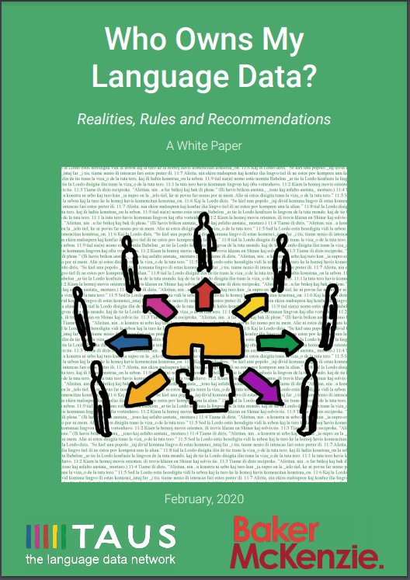
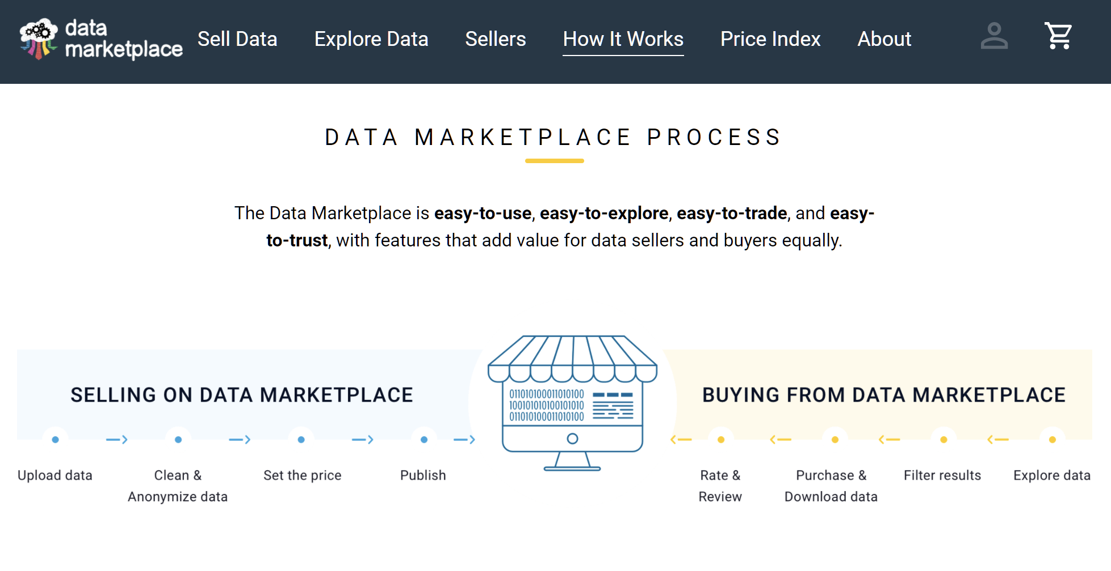
Language Service Providers
Who owns the Translation Memories?
Have data to sell? Need data to buy?
Source
Source

Slide 29
Language Service Providers
How can language service providers help protect your company‘s data?
Choose an LSP who
will use only secure MT tools and translation tools which fit your requirements
can and will restrict freelance translators from using free MT tools and exporting data
will sign a framework agreement which guarantees you right of ownership of your Translation Memories
adheres to high standards such as ISO 13485 (complete traceability of all steps)

Slide 30
One of the greatest data security risks
= file exchange via e-mail

Slide 31
How to protect your data
Short summary
Risk | Protective measures
Free MT tools | Disable free MT tools in your company Create strict policies for use of free MT tools and train your employees
Paid MT tools | Choose a provider who doesn‘t use your data for other purposes is ISO 27001 or SOC 2 certified doesn‘t have any conflicts of interest (such as industry espionage)
Data transfer | Update your IT policies to restrict transfer of confidential or sensitive data via email Provide and use secure file transfer portals
Translation tools | Choose a tool which enables you to restrict use of free MT tools and exporting data
Language Service Provider | Choose an LSP who will use only secure MT tools and CAT tools which fit your requirements can and will restrict freelance translators from using free MT tools and exporting data will sign a framework agreement which guarantees you right of ownership of your Translation Memories adheres to high standards such as ISO 13485 (complete traceability of all steps)

Slide 32
Machine Translation – how to get started?
Machine Translation is significantly gaining in importance. However, technological advance also raises questions and sometimes insecurities.
What kinds of texts and language pairs are suited for MT? Do I need to be concerned about confidentiality and data protection? And, maybe most importantly, what technological aspects should be considered, especially with regard to localizing MadCap Flare projects?
MONDAY
TRACK 4
1:45 - 2:40

