Slide 1


Slide 2
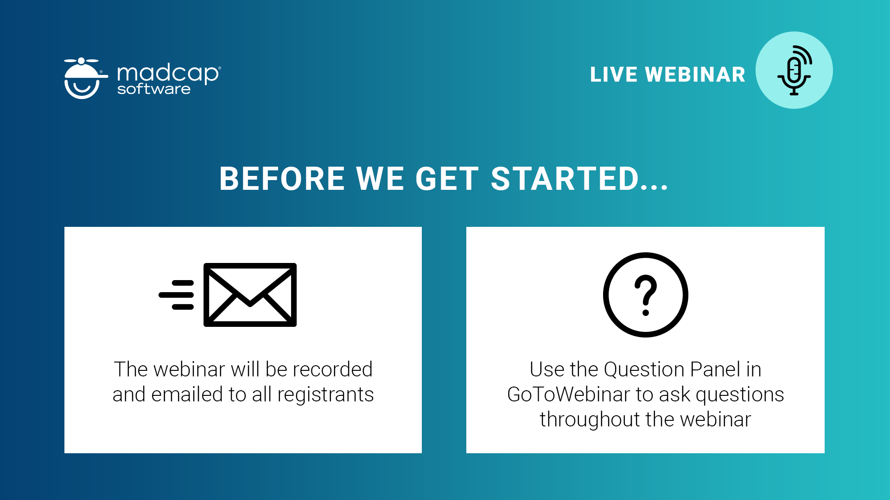

Slide 3
The indication
The reason
The idea
The task
1

Slide 4

The indication
When you repeat yourself.
Ask yourself: “do I really have to?”

Slide 5
The reason
The same Flare target files, across several Flare projects.
Their content is often not the same.
There are manual changes ahead

Slide 6
The idea
Control your all target files across all Flare projects.
Without opening Flare

Slide 7
The task
To make it happen
So we developed Target Control

Slide 8
2
What happens

Slide 9
What it does
Stores your target values in a data source and writes them to Flare target files.

Slide 10
3
Insights – the catch

Slide 11
For one tag value in same target
Source project
Project 1
Project 2
Project 3
No change
Value
Value
Value
Value
Different value
Value
Value
Value
Value
Changed value
Value
Value
Value
Value
Deleted value
+changed file
Value
Value
Value
Value
New value
+changed file
Value
Value
Value
Value

Slide 12


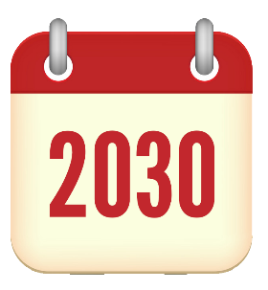



Over time
Open
Find
Evaluate
Change
Build
Open
Find
Evaluate
Change
Build
Open
Find
Evaluate
Change
Build
Open
Find
Evaluate
Change
Build
Open
Find
Evaluate
Change
Build
Build

Slide 13
4
Some numbers
(the bragging part)

Slide 14
∑
You have one Flare project, with one target, and one value tag.
We assume that it takes the same time to set a value in Flare as it does in Target Control. So that is left out of the math.
Also left out of the math
  any type of error
  any manual action
  any open/close of an incorrect project / target
  wait time to output is done and maybe redo things
  shift between opening / closing projects

Slide 15



∑
 |  |  | seconds
# project | # target | # condition | Open Flare | Open target | Find condition | Total
1 | 1 | 1 | 25 | 10 | 10 | 45
# variables
89.452
# output names
758
# PDF Options
12.236
# projects | # targets | # conditions | # variables |  | Seconds / time
12 | 658 | 23.500 | 302.886 |  | ~78 read & write
You will see this shortly!

Slide 16
5
Benefits

Slide 17
So …
Better control
Far fewer errors
Improved consistency
Huge return of investment
Quicker to change many values
Reduce manual labour to a cinch
Works with Flare version 8 and later
Time for other exciting assignments
Obscenely faster than the alternative
Easy comparison and overview across projects
Largely reduced post-editing after e.g. translation
Useful for translation, different markets, product types, etc.
Ah, Free your time

Slide 18
6
Ooops –
almost forgot

Slide 19
It’s targets
So of course Target Control can build all your targets, across all your projects.
Without opening Flare

Slide 20

7
Let’s see it

Slide 21
8
Roadmap

Slide 22
We have a plan
To further develop on Target Control
You are quite welcome to chip in with suggestions

Slide 23
The TBRO concept
We develop productive tools which will work across all of your Flare projects

Slide 24
If you need … something done, then we are ready to discuss and develop – for you

Slide 25
9
Pricing
and a bit

Slide 26

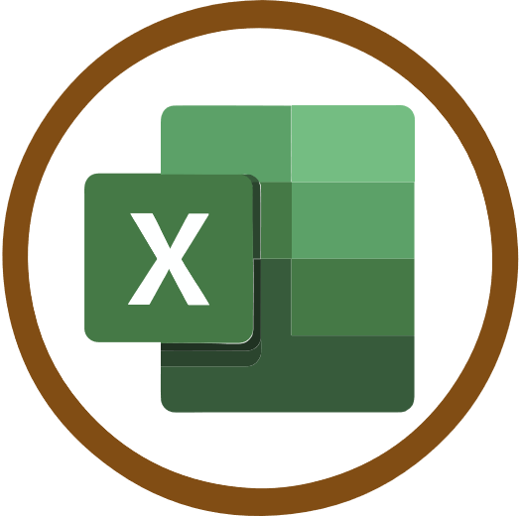




Check out these on TBRO.dk
10 facts
ROI tool
Download
Video
Demo
Pricing

Slide 27
License
95 USD / user /month
(1.140 USD billed annually)
Introduction offer
150 USD
off each license
Valid until 2021-03-01
For more licenses please contact us for a discount.
Prices are subject to change.
Tax and VAT included

Slide 28
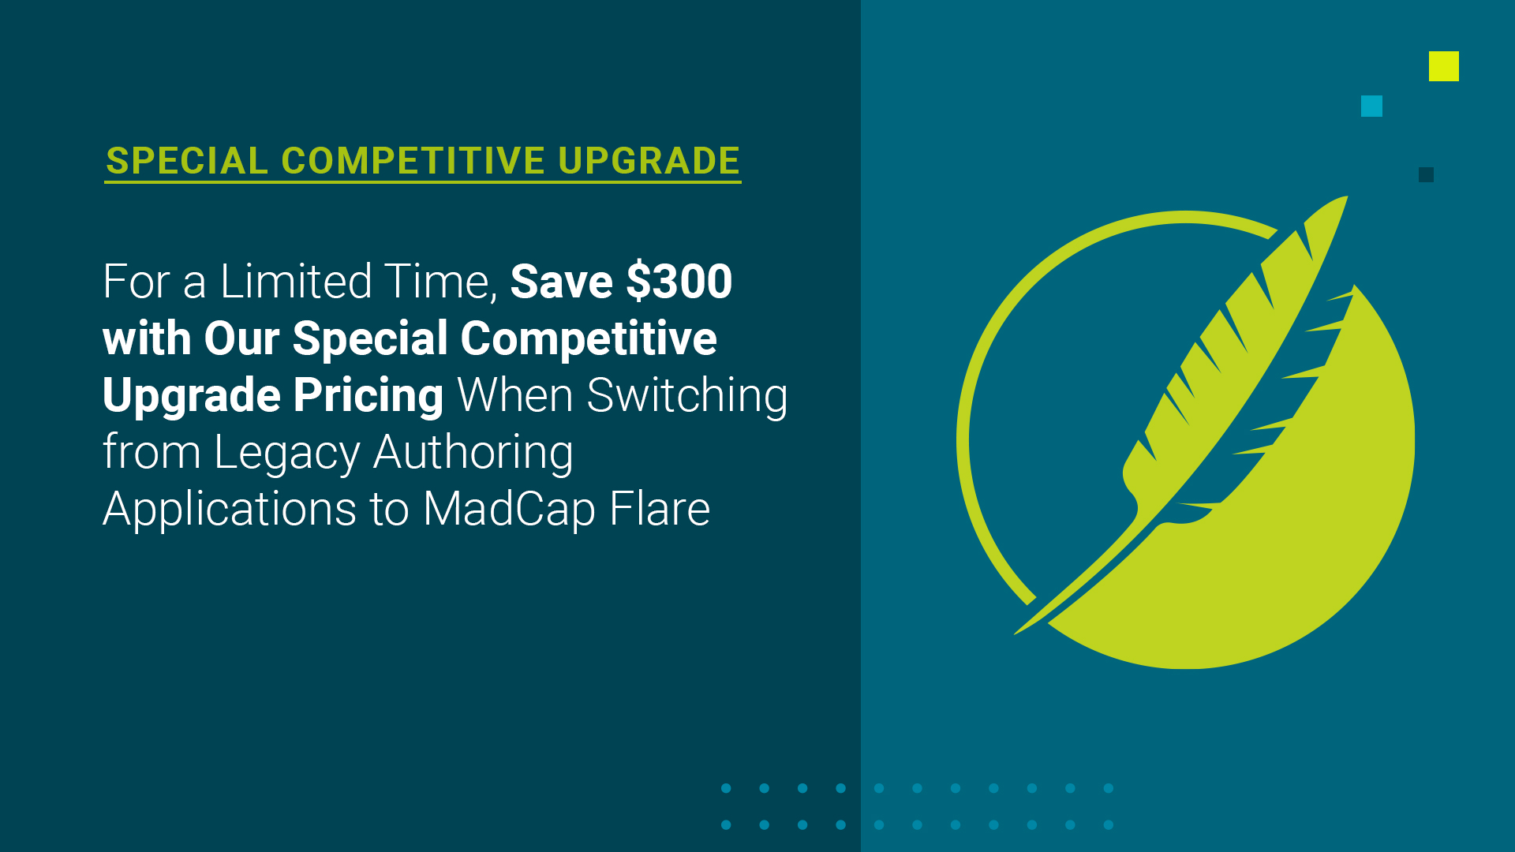


Slide 29



Slide 30
