Slide 1
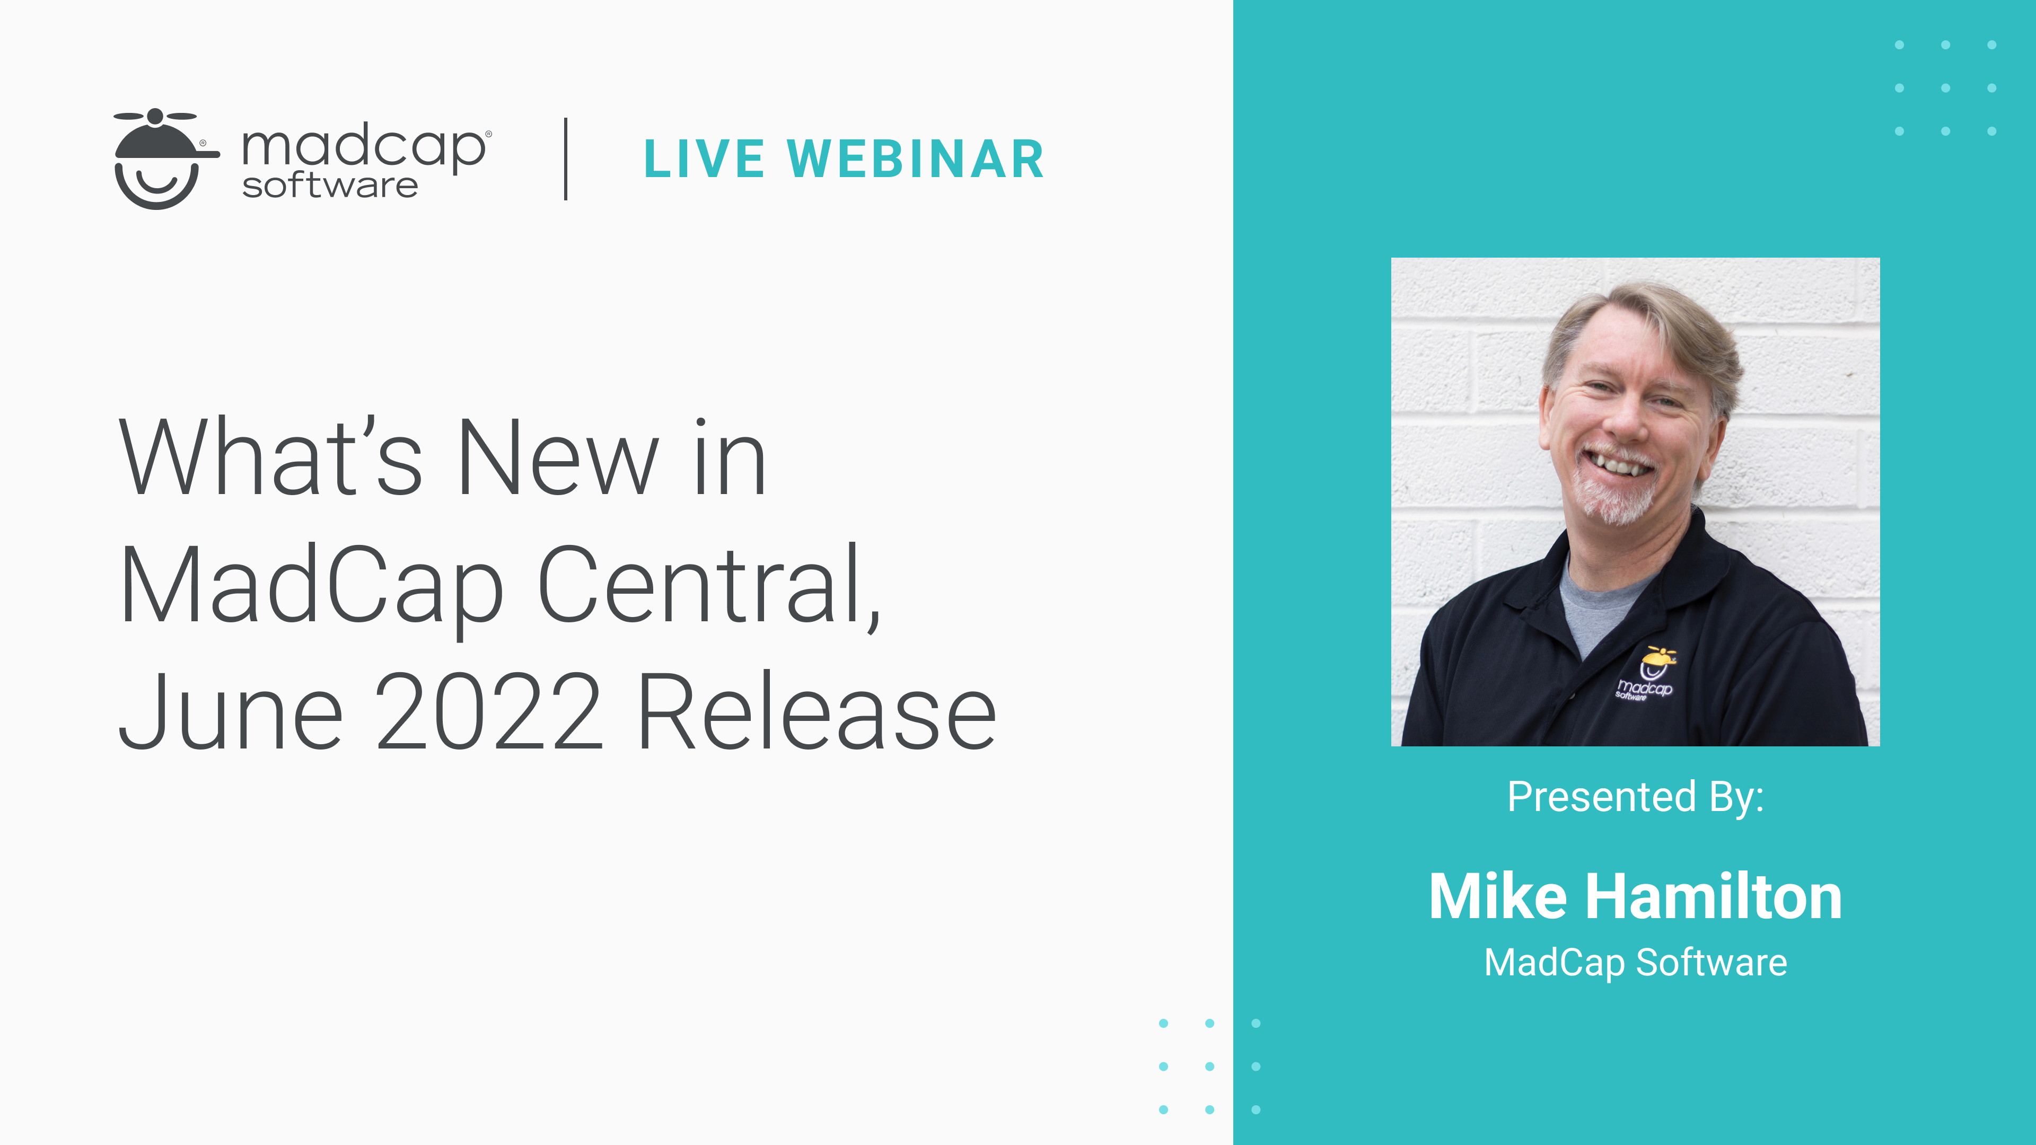

Slide 2
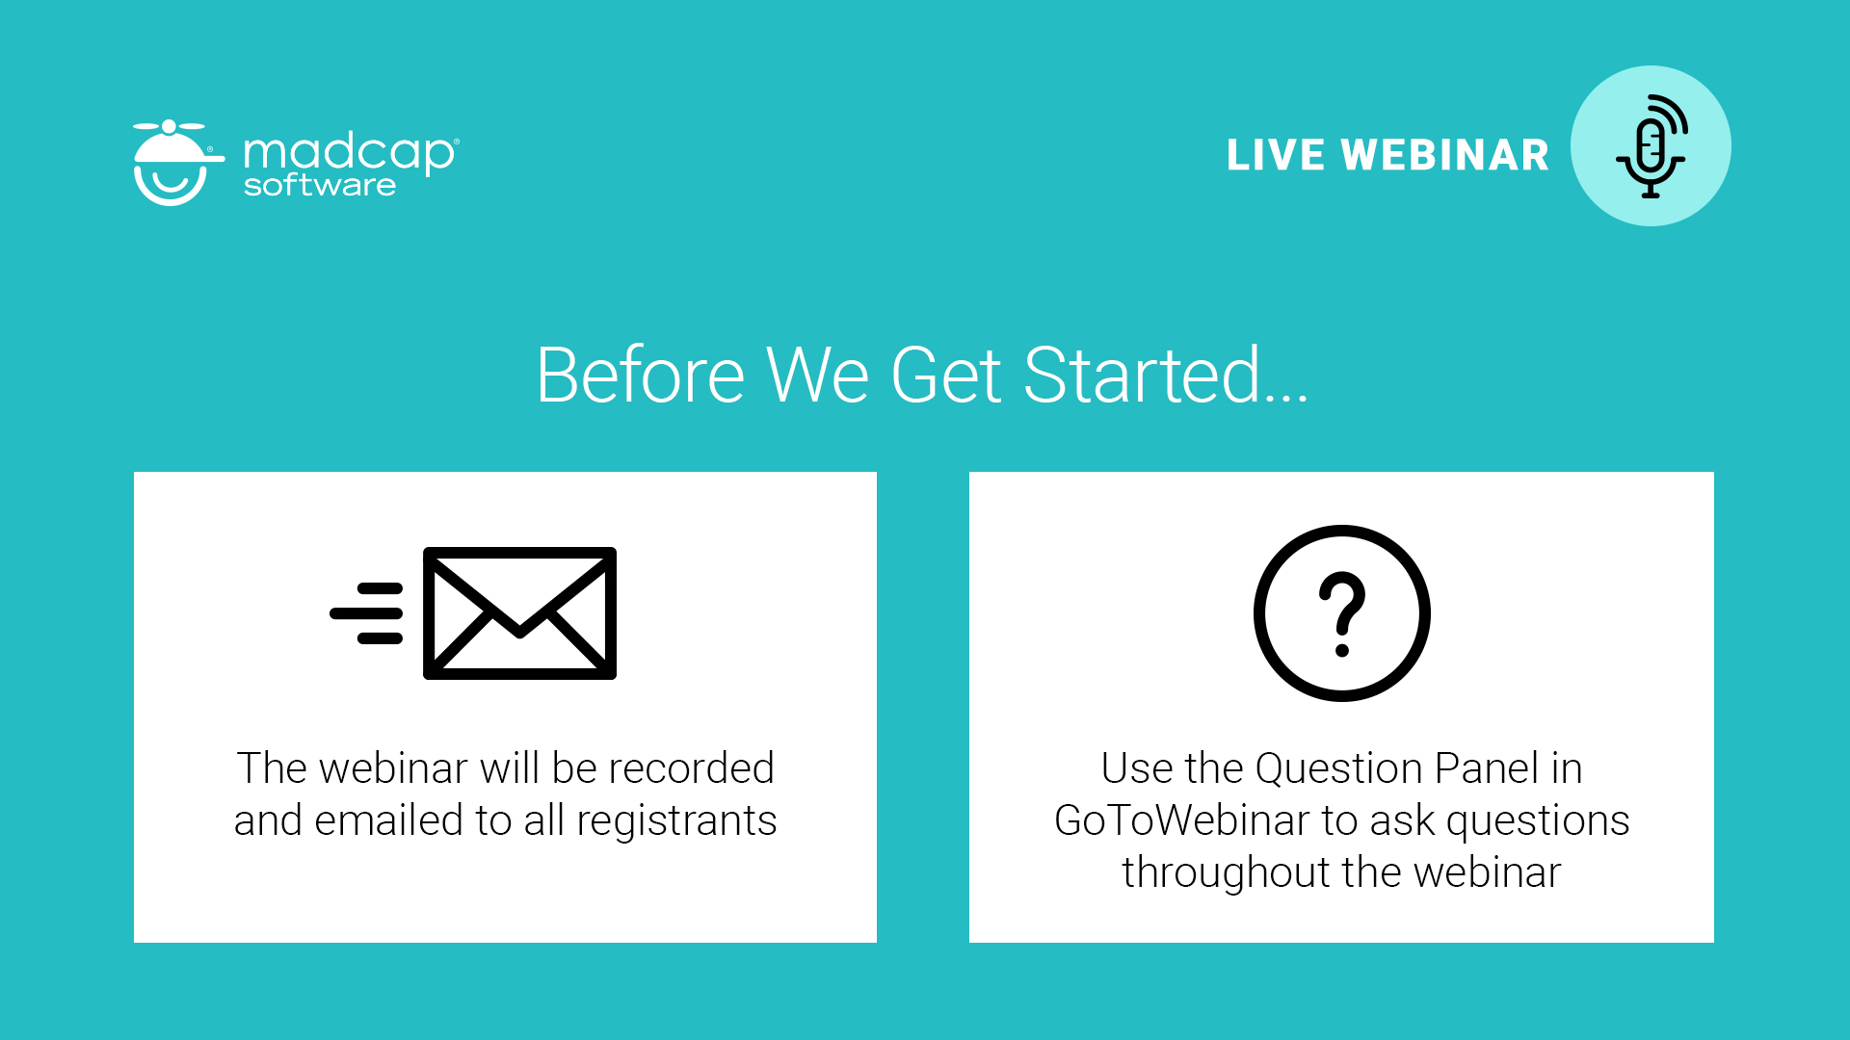

Slide 3
Expectations
Covered: What is NEW in MadCap Central
NOT Covered: Overview of MadCap Central
For an introduction/overview of MadCap Central:
MadCap Central Product Demonstration - YouTube
https://www.youtube.com/watch?v=-BIMiu2eWMs

Slide 4
New Items (agenda)
Access Enhancements to Projects, Teams, and Users
Project Profile Overview
Security Settings
Task Board Profiles
Team Permissions

Slide 5
Access Enhancements to Projects, Teams, and Users
Option renamed
Expandable tree view
Associate projects, teams, and users with each other
Associations between projects, users, and teams are separate
Helps prevent association breaks

Slide 6
Access Enhancements to Projects, Teams, and Users

Slide 7
Project Profile Overview
Easy-to-read summary
Date created and modified
Number of live sites and builds
Build and project file storage usage

Slide 8
Security Settings
Password history requirement
Password minimum

Slide 9
Task board profiles
New icons for task boards
Click icon to open and manage task board

Slide 10
Team permissions
Set same permissions for all users on team
Does not conflict with user permissions

Slide 11
Team permissions

Slide 12
New Items (Summary)
Access Enhancements to Projects, Teams, and Users
Project Profile Overview
Security Settings
Task Board Profiles
Team Permissions

Slide 13


Slide 14


Slide 15


